Slide 1

Information on your future after Year 11
  April
  2022

Slide 2


Options after GCSE’s

Slide 3
Many options available
Apprenticeship
Work part-time & study
part-time
A-levels
T-Levels
BTEC’s
Traineeship

Slide 4
Do you know the differences in these qualifications?
What is the difference between A-Levels and a BTEC?
What do T-levels involve?
Can I still go to university if I study a BTEC?

Slide 5
A-levels
Most students study 3 subjects. Some students may pick 4 subjects initially to keep options open. In exceptional circumstances (students achieving 8 & 9 grades) may consider studying 4 subjects.
Important to consider - Quality v Quantity
Academic route – Exam focused. How well you do after 2 years of study.
Graded A* - F grades
EPQ – Extended Project Qualification – Worth half an A-Level, can apply for this option while in Year 12 in addition to you’re A-levels. Lots of independent work required.
Many institutions offer A-levels, including: NDHS (need 39 points over your top 8 subjects). Also, CNS, Sir Isaac Newton/Jane Austen, City College Norwich, East Norfolk Sixth Form College, Bungay Sixth Form, Wymondham College, Lowestoft Sixth Form College, Paston College or UTC.

Slide 6
BTEC’s
BTEC – stands for Business and Technology Education Council
Vocational Pathway – Focusing on a specific subject e.g. engineering, art, business, beauty, animal care.
Flexible – take alongside or instead of GCSE’s or A-levels.
Every student takes core units, which provide a broad foundation and understanding about the sector
Optional units – enables you to focus on particular interests and plans for next steps
Less exam focus more continuous assessment. 50 % or more is coursework based
Work experience is part of many courses
Available at Colleges including City College Norwich, Easton College, , Access Creative College, East Norfolk Sixth Form, East Coast College, Poultec Training, St Ed’s.

Slide 7

Apprenticeships
An Apprenticeship is a way for you to earn (Min £4.81 per hour) while you learn in a real job, gaining a real qualification and a real future.
Apprenticeships are available in over 1500 job roles across 280 skills and industries from engineering to veterinary nursing, accounting to digital media.
Must have a back up of a full-time course as no guarantee of securing an apprenticeship – It’s competitive
Benefits of an apprenticeship –
  Earn a salary whilst in a real job
  Learn job specific skills
  Gain a variety of transferable skills
  Progress into higher education
  Work towards nationally recognised qualifications

Slide 8
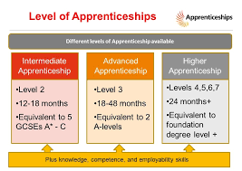
Apprenticeships Cont.

Slide 9

T-Levels
New technical based qualification, introduced between 2020 and 2023
Equivalent of 3 A-levels – two year course
Have been developed in coloration with employers and business so the content meets the needs of industry and prepares students for work
Mixture of classroom learning and ‘on-the-job’ experience
At least 315 hours (approximately 45 days) of work experience
Available in a variety of areas including: childcare, engineering, digital, healthcare , science, business, construction
T-levels currently available at City College Norwich, East Coast College, East Norfolk Sixth Form, Paston College, Thorpe St Andrew 6th form

Slide 10
Educational levels – Your journey
Level | Academic Route | Vocational Route
Level 1 | GCSE’s - Grades 3-1 | Foundational Learning BTEC Level One
Level 2 | GCSE’s – Grade 4-9 | BTEC level 2 Intermediate Apprenticeship
Level 3 | A-levels T-Levels | BTEC Level 3 Advanced Apprenticeship
Level 4 & 5 | Foundation Degree | Higher Apprenticeship
Level 6 | Batchelors Degree | Degree Apprenticeship
Level 7 | Masters

Slide 11


The Golden Rules
You have to stay in some form of learning until you are 18.
If you do not gain a grade 4 or above in GCSE English and Maths you are expected to continue studying these subjects after Year 11, alongside another course

Slide 12
How will I decide where to progress on to after my GCSE’s?
Lots of choice – Make an informed decision
Open days - They are happening from late Sept 2022 – Dec 2022. Dates will be available via your form tutor, google classroom or on www.helpyouchoose.org
Do your research prior to open day
Look at what courses/subjects they offer that might be of interest & impact on future career ideas
How will I get to the provider? Walk, bus, train?
Other information important to me about the learning environment e.g. extra curriculum, EPQ, private study areas.

Slide 13
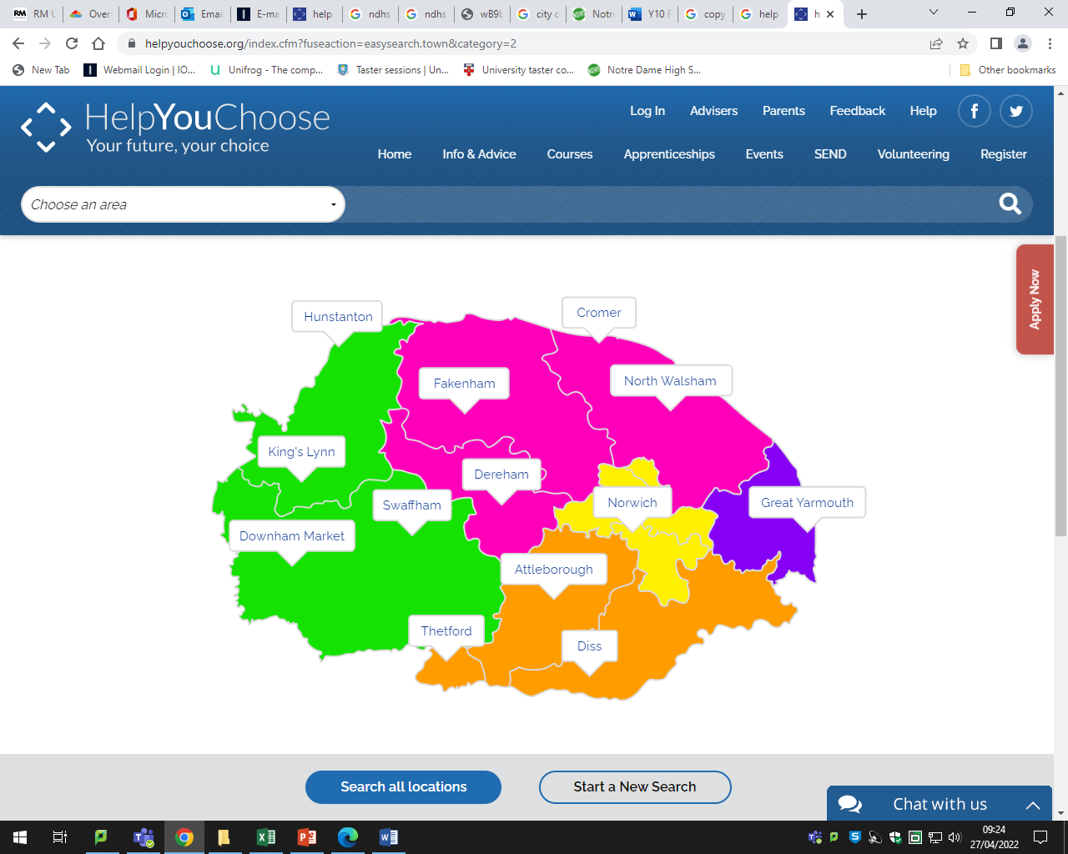
Where will I study?
https://helpyouchoose.org/index.cfm?fuseaction=easysearch.town&category=2

Slide 14
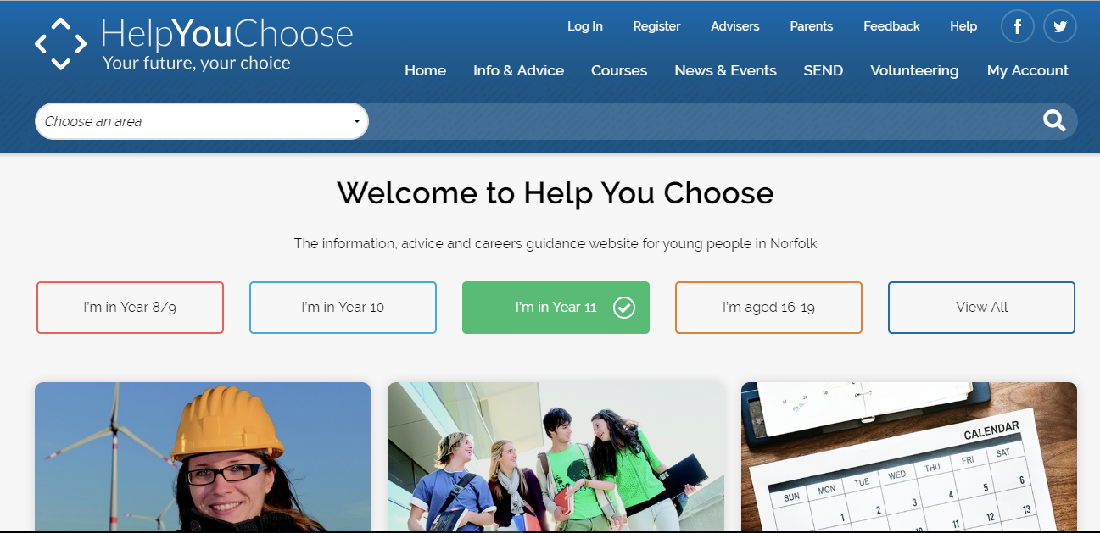
How Do I Apply For My
Post 16 Course/s
Helpyouchoose website
Sixth Form/ College own website.
  NDHS must apply by school website: https://www.ndhs.org.uk/sixth-form
Apply to up to 3 courses (including back up plan)

Slide 15
How to decide where & what to study
Consider what subjects you enjoy and what you are good at.
What are your predicted and aspiration grades? How far are your current grades away from course entry requirements?
Does the institution have a blocking scheme? If so, do the subjects fit in with my interests?
Do I want to go to university in the future? If so what subjects might be useful for my future degree ideas?
Do I want to study in a different environment? Less travelling?
What type of jobs are there available? What industries are growing? Looking at labour market information (LMI) is important.

Slide 16
Support Available
Speak to subject teachers – Suitability to a particular subject/course.
Attend open events .
Research interested degrees via www.ucas.com – Look at what the entry requirements are? For certain degrees you will need to study specific A-levels/BTECs.
Request a careers guidance appointment with Siobhan Whiddett
  By e-mailing: swhiddett1@ndhs.org.uk,
  Complete form on school website or
  via your form tutor or Head of Year

Slide 17

Key points
Attend open days – at least two.
Apply to up to 3 institutions including a back up plan (Plan B), by end of November 2022.
Some institutions have early cut off dates, so important to check individual institution closing dates for applications.
Apply via www.helpyouchoose.org or education institution website.
If wanting to progress on to an apprenticeship you must have a back up of a full-time course application, as no guarantee of securing an employer.
School website – Careers section has lots of useful information regularly updated.
Book a careers guidance appointment if unsure of next step.

Slide 18
Schedule
Date | Event
Spring term 2022 | PSHEE lessons – Employability skills and career pathways
Sept 2022 | Assembly - Reminder of post 16 options & how to apply for next steps
Sept/Oct 2022 | Assembly on apprenticeships
Sept – Nov 2022 | Attend at least two college/6th form open events.
By end Nov 2022 | To apply for 6th form/college. Must include a plan A and a plan B

Slide 19

CAREERS BLOG
https://www.ndhs.org.uk/careers
Check out the new NDHS careers blog!
You can find it under the careers page or your year group home page.

Slide 20
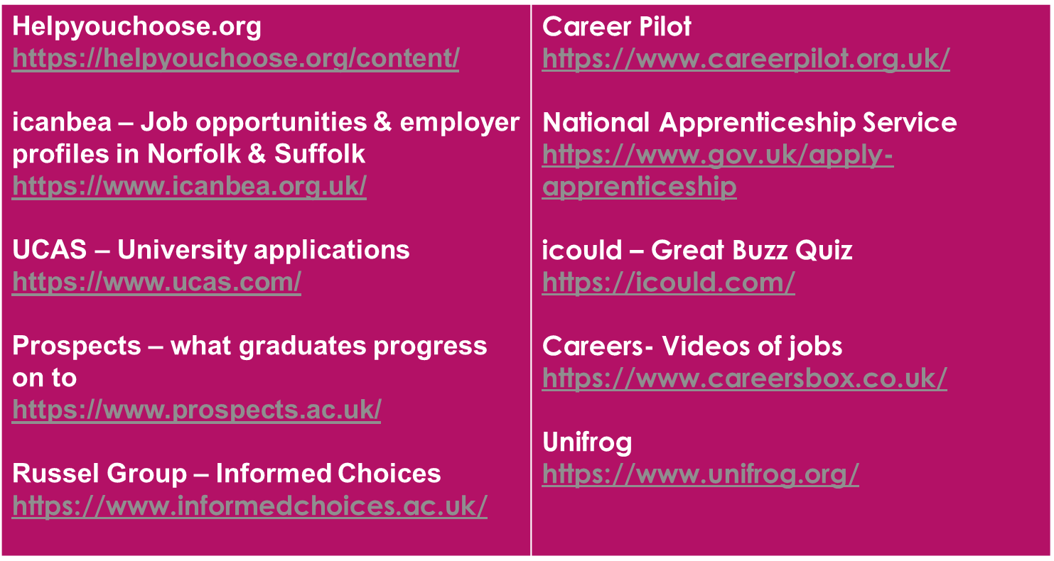
Useful websites for further research

Slide 21

Final words
Do your research – Important to make an informed decision.
Journey are not always straight maybe bumpy, bendy ride
Your teachers, parents, careers advisor will be able to help you make your decision on where you should apply
Important to have a plan A and Plan B

