Slide 1



Welcome
Year 11 Parents and Carers Information Evening: Post-16 Options 2026
Careers Education, Information, Advice & Guidance

Slide 2


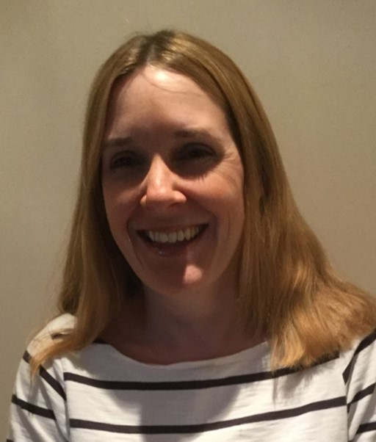
Welcome
Kate Freezer
Assistant Headteacher
(Aspirations and Outcomes)
Careers Lead
Siobhan Whiddett
Careers Advisor

Slide 3
Session Objectives
Options available Post-16
Research and considering the best options
Notre Dame 6th Form
Support and Guidance
The Application Process

Slide 4


Post-16 Options
SWH

Slide 5

Young people must stay in some form of learning until they are 18.
If students do not gain a grade 4 or above in GCSE English and Maths they are expected to continue studying these subjects after Year 11, alongside another course.

Slide 6
Post-16 Options
A-levels
T-Levels
BTEC’s
Apprenticeship
Work part-time & study
part-time
V-levels

Slide 7

Post-16: 3 Main Routes
Qualifications fall into 3 main categories:
Academic | Vocational | Vocational/Technical
GCSEs/A Levels | BTECs/NVQs/T Levels/ V-levels | Apprenticeships

Slide 8

Educational Levels – Your Journey
Level | Academic Route | Vocational Route
Level 1 | GCSE’s - Grades 3-1 | Foundational Learning BTEC Level One
Level 2 | GCSE’s – Grade 4-9 | BTEC level 2 T-Level Transition Intermediate Apprenticeship
Level 3 | A-levels | T-Level V-Levels BTEC Level 3 Advanced Apprenticeship
Level 4 & 5 | Foundation Degree | Higher Apprenticeship
Level 6 | Batchelors Degree | Degree Apprenticeship
Level 7 | Masters

Slide 9
A-levels
3- 4 subjects.
Important to consider - Quality v Quantity
Academic route – Exam focused.
How well you do after 2 years of study.
Graded A* - E grades
Consider – Do I need certain A-levels to study a particular degree?

Slide 10
V-Levels – *NEW *
V-Levels Overview
  V-Levels are Level 3 vocational qualifications equivalent in size to one A-level, focusing on practical workplace skills.
Industry Focus and Availability
  Launching from 2027, V-Levels will cover sectors including:
    Education, Finance, and Digital, aligned with employer demand.
Comparison with A-Levels
  A-Levels emphasize theory and exams; V-Levels focus on real job roles and practical skills for employability.

Slide 11

T-Levels & T-level Transitions
Equivalent of 3 A-levels – two-year course
Have been developed in collaboration with employers and business, so the content meets the needs of industry and prepares students for work
Mixture of classroom learning and ‘on-the-job’ experience
At least 315 hours (approximately 45 days) of work experience
T-level Transitions – Level 2, one year course for students that have not reached the entry requirements for a T-level

Slide 12
What T Levels Can I Study?
Agriculture, Land Management & Production
Building services engineering for construction
Onsite Construction
Digital business services
Digital production, design and development
Digital support services
Education and Early Years
Accounting
Health – Support Adult Nursing
Healthcare science
Maintenance, installation and repair for engineering and manufacturing
Management and administration
Onsite construction
Science
Design, surveying and planning for construction
Engineering, manufacturing, processing and control
Please note the title of course may differ

Slide 13
Where Can I Study T-Levels?
Access Creative College
City College Norwich
Easton College
East Norfolk Sixth Form
East Coast College – Lowestoft & Gt Yarmouth Campus
Lowestoft Sixth Form
Paston College
Thorpe St Andrew Sixth Form
UTCN

Slide 14


Apprenticeships
You work for an employer doing a real job
You get recognised training from a training provider
20% of the time must be off the job training
You work towards nationally recognised qualifications
You get paid - Min of £8 per hour
You develop the skills that employers really want
Competitive
Notes:
If being in the classroom full time isn’t for you, there are a wide range of apprenticeships available. You can explore them at Norfolk.gov.uk/apprenticeships
Recommend that you book an appointment with Siobhan Whiddett our careers advisor if you are considering apprenticeship
Also have a back up alternative to apprenticeships as these are not always guaranteed

Slide 15
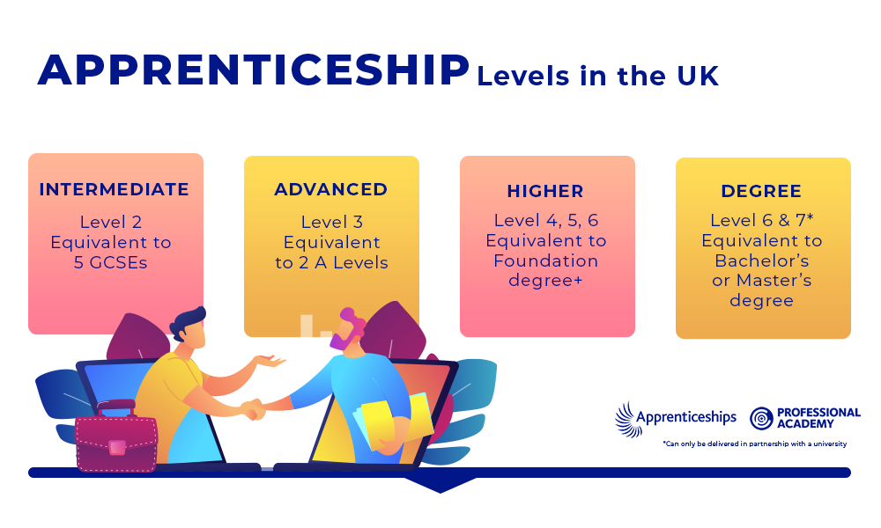

Slide 16

Post 16 Options
Deciding which option is best will
depend on a number of factors…
KFR

Slide 17
Entry / Admissions
Understand what current studies will result in
POINTS MATTER!
Calculate the total of your top 8 predicted grades.
English Lang and Lit = 2 GCSE (e.g.4+4)
Triple Science = 3 GCSE
Double Science = 2 GCSE
Notice whether your young people are predicted a 4 or above in Maths and either English Lang or English Lit.

Slide 18
Entry / Admissions
5 passes at grade 5 and above
5 passes at grade 4+ (including) English and Maths
Grade 6 in Maths and Sciences
It is important to find out what grades are required to be able to apply to a course or institution.

Slide 19
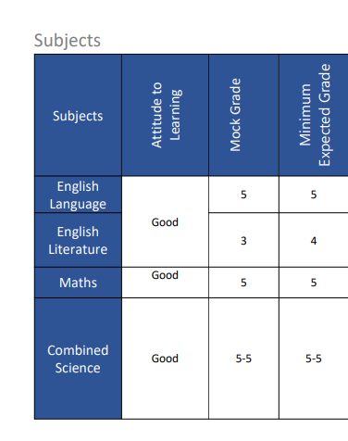
Check your child’s Year 10 Summer Report
The Minimum Expected Grade will help you to see what teachers are currently expecting your child to achieve.
Check if English and Maths are at least a grade 4.
Add up the best 8 scores to get the total points score.

Slide 20

Factors to Consider
Courses: Likes, structure, assessment, “get out of bed” test
Career: What do you want to do?
Campus: Where would you learn best? Where are you willing to travel to?
jmk

Slide 21

How to decide where & what to study
Consider what subjects you enjoy and what you are good at.
How is the course/qualification assessed? Does it play to my strengths?
What are your predicted and aspiration grades? How far are your current grades away from course entry requirements?
Do I want to go to university in the future? If so, what subjects might be useful for my future degree ideas?
What industries are growing? Looking at Labour Market Information (LMI) is important.
Notes:
Remind Unifrog contains labour market information

Slide 22


The Importance of Choice
1.The aspirational application
2. The insurance application
3. Further back-up
afx

Slide 23


Research
Studying in Norfolk?
HelpYouChoose.org is the best way to
look for course providers in Norfolk. They also
list some providers in Suffolk.
You can search by provider, subject, location or
type of qualification you wish to study.

Slide 24


Research
Studying in Suffolk?
thesource.me.uk is another way to
look for course providers in Suffolk.
The Choices at 16+ section has links
to a variety of different routes and the different providers.

Slide 25
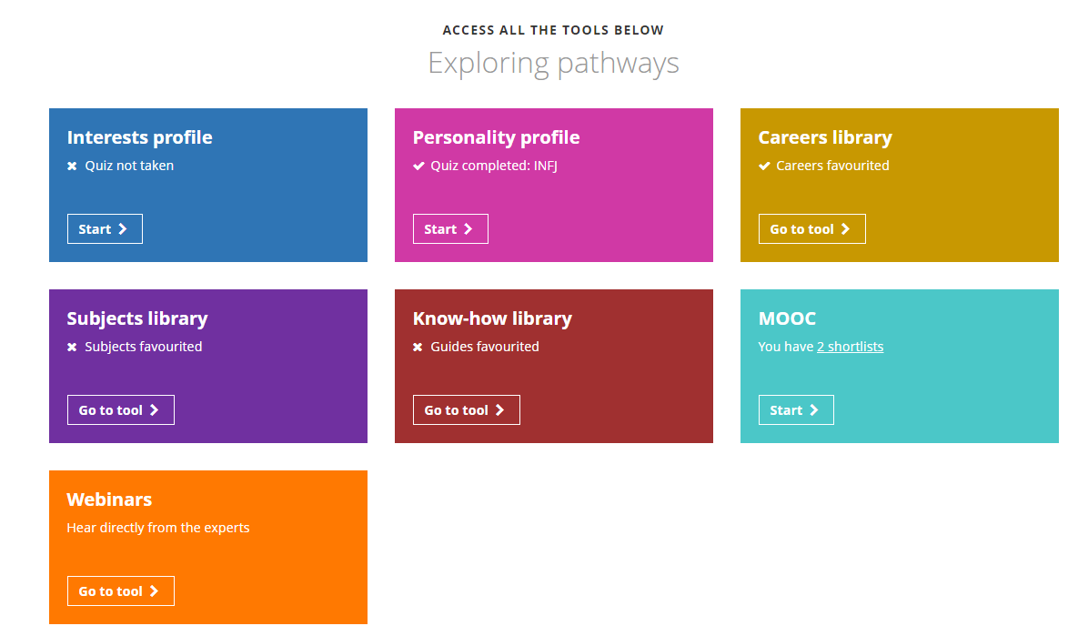

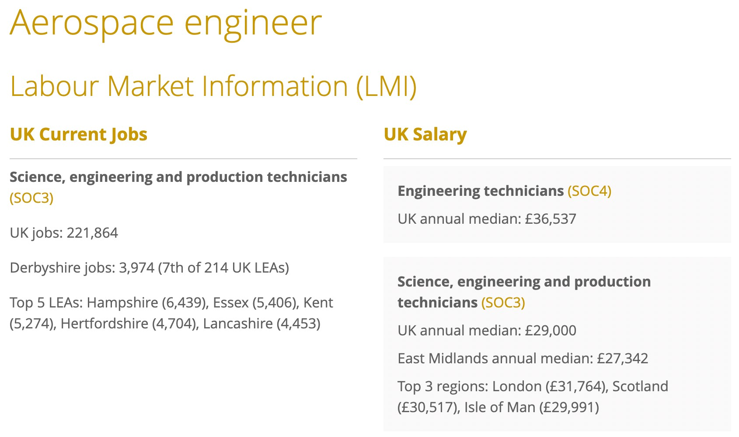
Research
If students need help with their log ins – email Careers@ndhs.org.uk
Notes:
Interests/personality profile
Careers Library
Subject library
Labour Market Information

Slide 26

Research
https://www.ndhs.org.uk/careers
Check out the new NDHS careers blog!
You can find it under the Careers page or the year 11 page.

Slide 27
Research
Visit Open Days/Open Evenings so that an informed decision can be made
Look at what courses/subjects they offer that might be of interest & impact on future career ideas
Does the institution have a blocking scheme? If so, do the subjects fit in with my interests?
Consider transport? Walk, bus, train?
Other important information – e.g. learning environment e.g. extra curriculum, EPQ, private study areas.
jmk

Slide 28

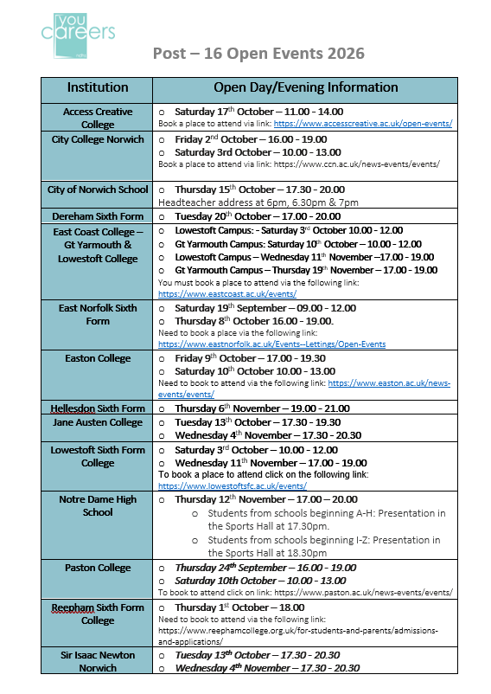
Notre Dame Open Evening is Thursday 12th November
Open Days / Open Evenings
Upcoming Events
Thursday 24th September: Paston College
Thursday 1st October: Reepham Sixth Form College
Friday 2nd and Saturday 3rd October: City College Open Evening and Open Day
Saturday 3rd October: Lowestoft Sixth Form College
Saturday 3rd October: East Coast College
Thursday 8th October: UTCN
Thursday 8th Oct – East Norfolk sixth Form
Thursday 8th October: Taverham Sixth Form
Thursday 8th October: Wymondham College
Friday 9th and Saturday 10th October: Easton College

Slide 29

Entry is based upon GCSE results
A minimum of 42 points over the best 8 GCSEs
English & Maths – 9,8,7,6,5,4,3,2,1
The best 8 must include a grade 4 in Maths and English
Many subjects require certain grades
e.g. MFL (6), Maths (6), Sciences (6 +Maths 5/6)

Slide 30
Open Evening
Thursday 12th Nov.
Deadline for applications Dec.
Please see website for more details.

Slide 31
My offer to all ND Yr11 Students
A guaranteed place
Hit the deadline and get 42 or more points in your best 8 GCSEs (INCLUDING English and Maths)
and you meet individual subject requirements.
Support to progress to the chosen course / college / VI Form / apprenticeship

Slide 32
Which A Levels?
Depends on the university / college
Research/UCAS/Unifrog
The subject matters
What do (some) universities want?
GCSE – Maths & English – min grade 4 or 5
MFL GCSE
Interview
Evidence of Extra Curricular activity
Russell Group: www.informedchoices.ac.uk
Notes:
Siobhan wanted us to add in a bit about the website informedchoices.ac.uk – to replace the Russell Group bit. It’s a good website – you put in what career you want and it tells you what subjects you could do for A level.

Slide 33
On track for VI Form or College?
Where are you now?
Q
On track for 4 or above in English and Maths?
Improvement needed?
Where are you now?
EPO

Slide 34

Supporting Your Child with
GCSEs and Revision
Resilient Pathways
Your child will have an assembly with the Resilient Pathways Team next half term.
They will be offering drop ins at lunchtime and invited students will be taking part in small workshops.
They are also offering Parent & Carer workshops, further information is on the hand out which you can collect on the way out.

Slide 35
Applications
How to apply

Slide 36


How to apply for 6th Form/College Courses
Apply via institutions website –
  NDHS must apply via school website
Apply via www.helpyouchoose.org
  Apply for more than one institution
Students use their email address to access Help You Choose.
Don’t forget to check application deadlines!
SWH

Slide 37

Application
Check the deadlines (different institutions will have different closing dates)
Places can fill up fast and most courses close by mid-December.

Slide 38
Next Steps
Aim to visit at least two open days/evenings
Apply to up to 3 institutions including a back- up plan (Plan B), by December 2026.
Some institutions have early cut off dates, so important to check
We will be contacting parents/carers in December and will ask you to complete a short Google Form so that we can track students’ progress in their applications.

Slide 39
Next Steps
If wanting to progress on to an apprenticeship students must have a backup of a full-time course application, as no guarantee of securing an employer.
School website – Careers section has lots of useful information regularly updated.
Book a careers guidance appointment if unsure of next step.

Slide 40
Independent Careers Advisor
Support Available
Request a careers guidance appointment with Siobhan Whiddett
  By e-mailing: swhiddett1@ndhs.org.uk
  or
  Complete the form on the Careers page of the school website
  or
  via your form tutor or Head of Year

Slide 41

Points to Remember
Attend
Attend more than one open day/evening
Be prepared before going to the event
Apply
Apply for 2-3 courses including a backup plan by end Nov 2025
Look
Look realistically at your predicted grades V entry requirements
Ask
Ask questions
Seek
Seek Support – Careers Advisor, Teachers
GCSE results day – Thursday 19th August 2027

