Slide 1
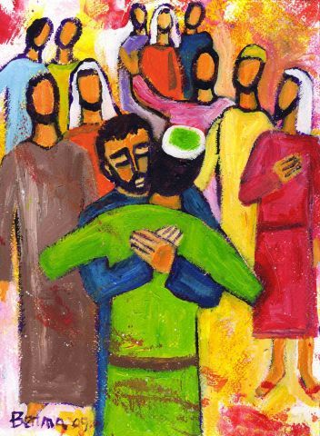
Forgiveness
THE COMMON GOOD
Develop a fair and just society for all to flourish
24th Sunday of Ordinary Time

Slide 2


In the name
of the Father
And of the Son
And of the
Holy Spirit
Amen
Notes:
The emphasis is on co-operation. We are all in it together and in a community every individual would be expected to participate in the life of the whole.

Slide 3

A reading
from
THE GOSPEL
According to
MATTHEW

Slide 4
At that time: Peter came up and said to Jesus, ‘Lord, how often will my brother sin against me, and I forgive him? As many as seven times?’
Jesus said to him, ‘I do not say to you seven times, but seventy times seven.

Slide 5

The Gospel of the Lord
ALL: Praise to you Lord Jesus Christ.

Slide 6
Scripture Sound Bite
‘how often must I forgive…?’
Matthew 18:21-35
We have times in our lives when we make mistakes and need to ask for forgiveness.
However, it is often the most difficult Gospel Value for us to give to others.
Being able to forgive others is an ability that we need to develop every day.
Often the person that find it most difficult to forgive is ourselves.

Slide 7


Career Pathways
Y7 – Career Myth Busting Event
Y8 – Work Shadowing
Y9 – Careers Networking Event
Y10 – Work Experience
Y11 – Post 16-Options

Slide 8

Careers
Y10 Work Experience
Monday 5th – Friday 9th July

Slide 9
Year 10 Work Experience
Monday 5th – Friday 9th July
You will not come to school on these 5 days and instead you will take part in work experience to gain an insight into a workplace.
You will need to organise your 5 day placement with an employer of your choice.
Afterwards, you will complete a reflection and evaluation based on your experience and consider how this has shaped your future choices.

Slide 10
Choosing a Work Experience Placement
You may choose a work placement based on your interests or future careers ideas.
or
You could choose a work placement based on locality, convenience and ease of travel.
Any workplace experience will be valuable.

Slide 11
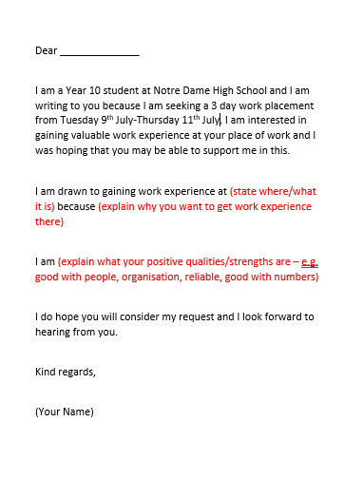
Choosing a Work Experience Placement
Contacting Potential Employers
You will need to find your own work
placement.
You can email prospective hosts,
telephone, or you may wish to pop into
a place of work and speak to a
manager directly.
We have provided you with a template
email to use, to get you started.

Slide 12
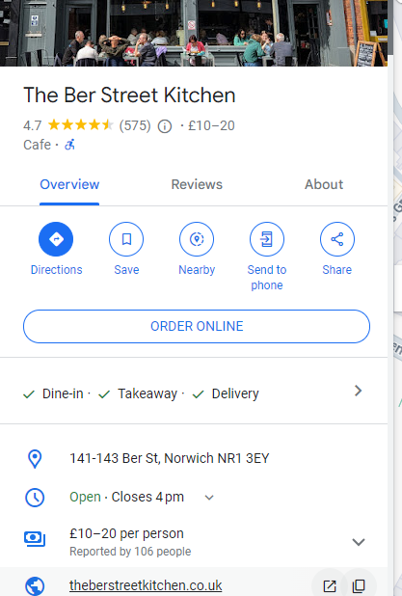
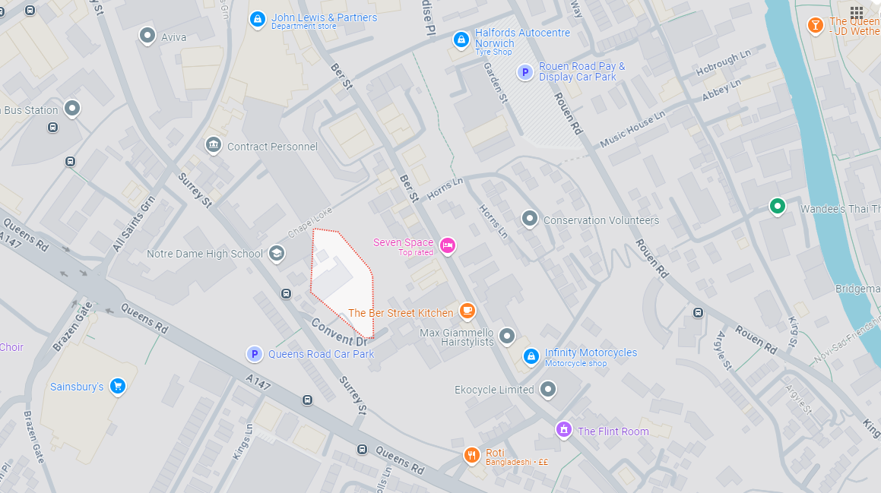
Choosing a Work Experience Placement
Google Maps – search your postcode
to find local employers and their contact
details.

Slide 13
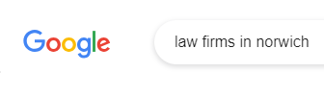
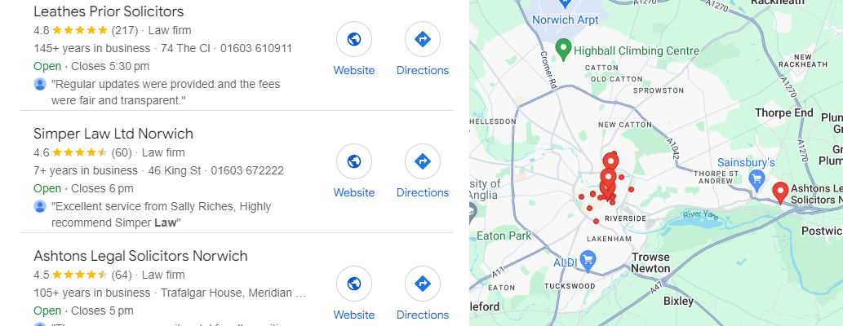
Choosing a Work Experience Placement
Or search for a specific type of employer

Slide 14

Healthcare
NHS have a limited number of spaces and offer specific programmes at specific times of the year. Please check if next year’s programme fits with the dates of our work experience week.
Please do not arrange placements with individual hospitals as they will only take students who are 18 and over.
You could try private clinics, care homes, physios or pharmacies.

Slide 15
Support
Miss Holden will be dropping into forms after half term, for any queries and questions.
We will run drop-in sessions for additional support.
You will also get opportunities for Unifrog guidance in a PC room during form time.
You can also email @careers to request help

Slide 16

Securing Your Placement
Once you have secured your placement with your employer you need to obtain accurate contact details for them and tell them that we will be using Unifrog to collect permissions and important documents.
We have produced a letter that you can send to your employer to inform them about the process.

Slide 17

Unifrog
Unifrog also contains some useful tips on securing a work placement.
It is also the place that you will log your chosen placement so that we can obtain information from your host and get permission from your parents/carers.

Slide 18
Deadlines
You have until Friday 11th June to secure and log your Work Placement on Unifrog.
Don’t delay in getting started – there are lots of students from other schools looking for Work Experience too.
Get organised and start now.
The final sign off for all completed Unifrog sections is 25th June.

Slide 19
Key Points
Anyone who does not complete the consent and risk assessment checks will not be able to take part. You will need to come to school as normal.
Anyone unable to find a work placement will need to come to school as normal.
Work placements must happen on the designated days only.

Slide 20
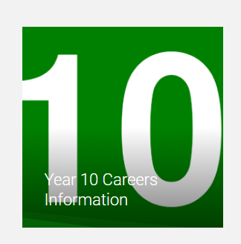
Further Support and Information
Your parents/carers have been emailed to inform them about Work Experience.
All the information you need can be found on your Y10 Careers Page of the website.
PSHE lessons will focus on Work Experience over the next fortnight.
We will run drop-in clinics for support too.

Slide 21

Prayer
We pray for the gift
of forgiveness.
Help us to follow Jesus’ example to forgive those who upset us.
Help us to also
forgive ourselves
AMEN

