Slide 1

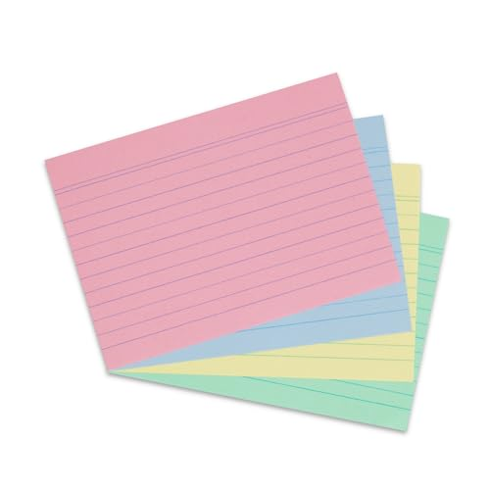



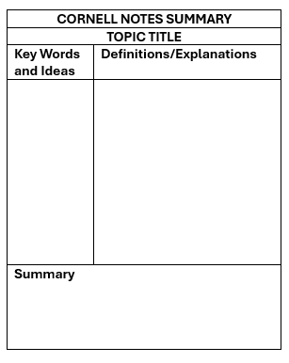




CODE: =
FLOAT
Create some revision notes
Create an annotated diagram
Memorise some key info
6 Ways to Revise
REVISION TRACKER | Summer 1 |  |  |  |  |  | Hol. | Summer 2
 | 20th Apr | 27th Apr | 4th May | 11th May | 18th May | 25th May | 1st Jun | 8th Jun | 15th Jun | 22nd Jun
Maths
Eng. Lang.
Eng. Lit.
R.E.
SWIM
Complete & mark short/low point practice questions
Recall key info from memory
Create a summary
Get someone to test you
❶ Flashcards
Put a question on the front
and the answer on the back.
❷ Visual Tools
Use colour, images, mind maps, timelines, annotate a diagram.
❸ Brain Dump
Write everything you can
remember on a specific topic
❹ Apps & Sites
Use online resources recommended by your teachers.
❺ Cornell Notes
Divide a page into 3 sections
Keywords
Definitions/explanations,
Summary
❻ Practice Questions
Use questions from revision resources or past papers,
then check answers.
DIVE
Subject specific revision strategy
Focus on a more challenging topic
Recall wider quotes/phrases
Complete & mark timed long answer/high mark questions
COLOUR CODE |  | LOW |  | MID |  | HIGH
At the start of each week, dot the subjects you plan to revise.
Colour in the right boxes to indicate how well you revised.
For subject specific advice
go to ndhs.org.uk/y10

