Slide 1



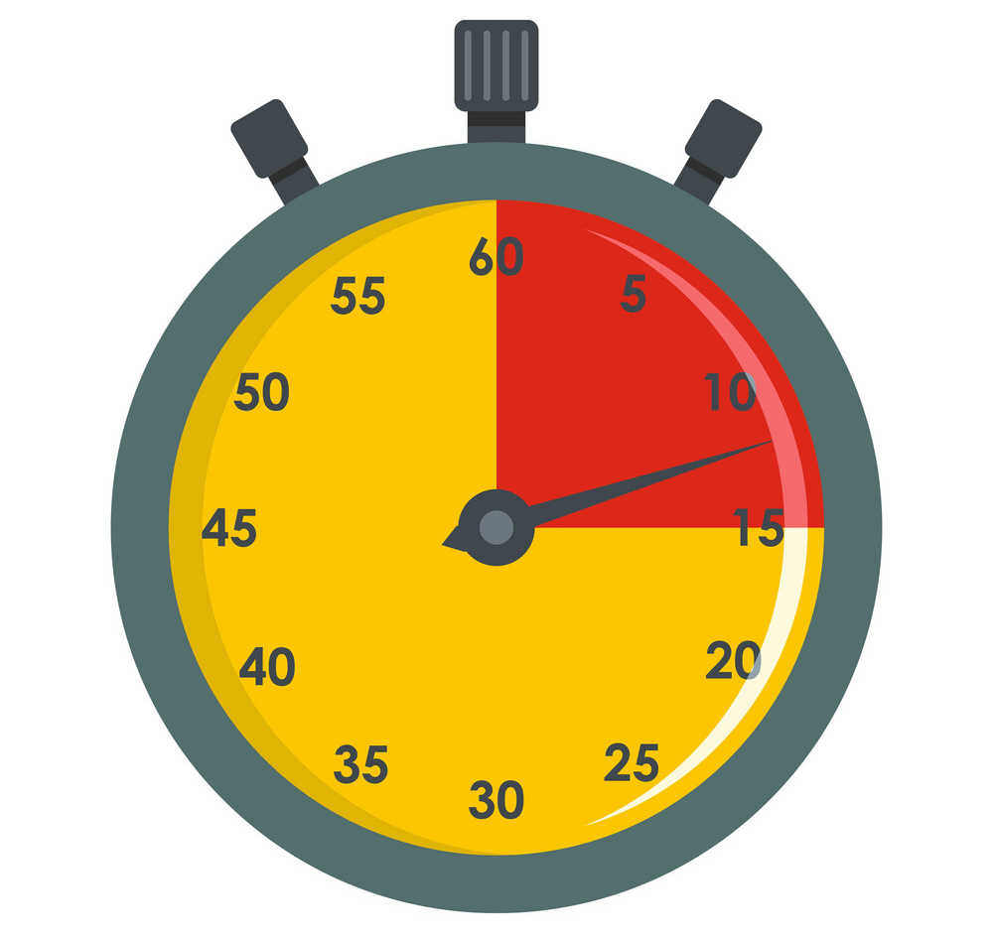
Name
Y11 REVISION
PLANNER
4 KEYS TO SUCCESS
Revise Actively - engage with the material, don’t just read. Self-Test - use practice questions to check what you need to revise. Recall from memory. What can you remember when you need it? Stay motivated - build in time off and rewards for work done.
ORGANISE YOUR TIME
Maintain a regular sleep pattern Minimise distractions Revise a mix of subjects each day Prioritise subjects that you need to pass or achieve a specific grade Revisit topics to reinforce recall Focus for 15 – 25 mins to self-test or revise, then break for 5 mins Plan times to eat and exercise
ORGANISE YOUR RESOURCES
Divide information into chunks. Use whatever helps you remember – colour, images, symbols. Create summaries using: Mind or concept maps Bullet point lists Grids or tables Hierarchy charts Annotated diagrams
SELF-TESTING IS THE MOST EFFECTIVE USE OF YOUR TIME
Use a variety of techniques that work best for you including: Practice/past paper questions to identify what to focus on Mini-revision fact cards (cue on the front, answer on the back) Write a summary and check what you missed Bullet point quick essay outlines from memory Use un-labelled outline diagrams and annotate fully to explain processes, causes and effects Do timed multiple choice/short answer questions Write 10-15 mins essays to cover breadth Team up with a revision buddy to test each other
Visit the Y11 PAGE on ndhs.org.uk for subject specific advice
and practice papers to help you revise.

Slide 2

Y11 Mocks Review
MOCKS Wellbeing Checks | Review
I ensured that I had a healthy sleep pattern | ☹ 😐 ☺
I ate healthy food and drank enough water | ☹ 😐 ☺
I planned downtime/social/exercise activities | ☹ 😐 ☺
I had a calm space to revise in | ☹ 😐 ☺
GCSE Wellbeing strategies to focus on
MOCKS Revision Checks | Review
I created an effective revision plan | ☹ 😐 ☺
I kept to my revision plan | ☹ 😐 ☺
My revision helped me to prepare well for the Mocks | ☹ 😐 ☺
I had the revision resources I needed to revise | ☹ 😐 ☺
I used practice questions to help me to identify what to revise | ☹ 😐 ☺
I used effective revision strategies to help me to remember and recall key information. | ☹ 😐 ☺
GCSE Revision strategies to focus on

Slide 3


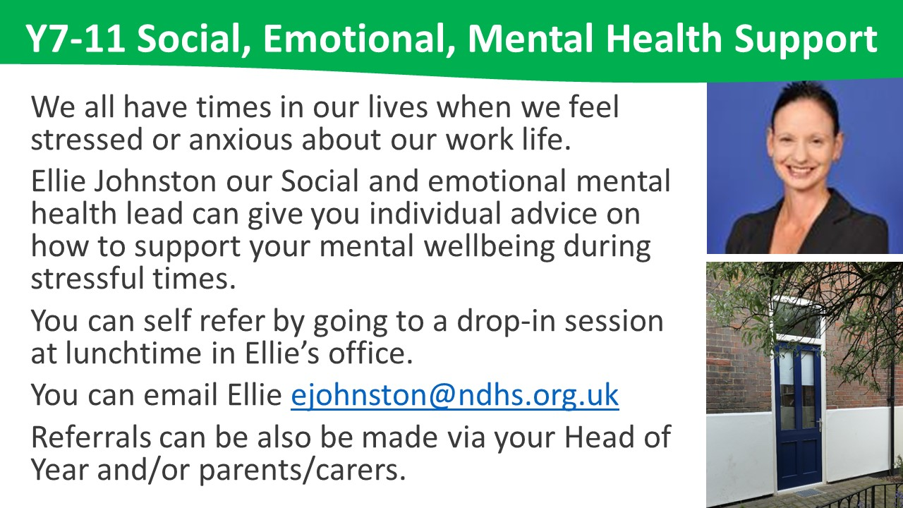
Kind Mind
TO
YOUR
Your family can support you in following ways:
Display your exam timetable in a common space
Check you have the revision resources
and stationary that you need
Organise a quiet uncluttered space
to revise without distractions
Stay hydrated to improve focus
Plan healthy meals and eat together
when possible
Plan downtime activities away from screens
Stay connected to friends and family
Agree an appropriate time to go to bed to achieve a regular sleep pattern

Slide 4

Breathing Meditation
Use this simple technique to calm and focus your mind.
Becoming aware of the silence
Relaxing your shoulders
Sense how the chair supports you
Open your hands and let them rest
Feel the ground supporting your feet
Slowing down breathing
Slowing down thoughts
As your mind wanders
Notice the thought
Bringing focus back
to the breath
Feeling calm and refreshed
‘ALL SHALL BE WELL’ Julian of Norwich

Slide 5



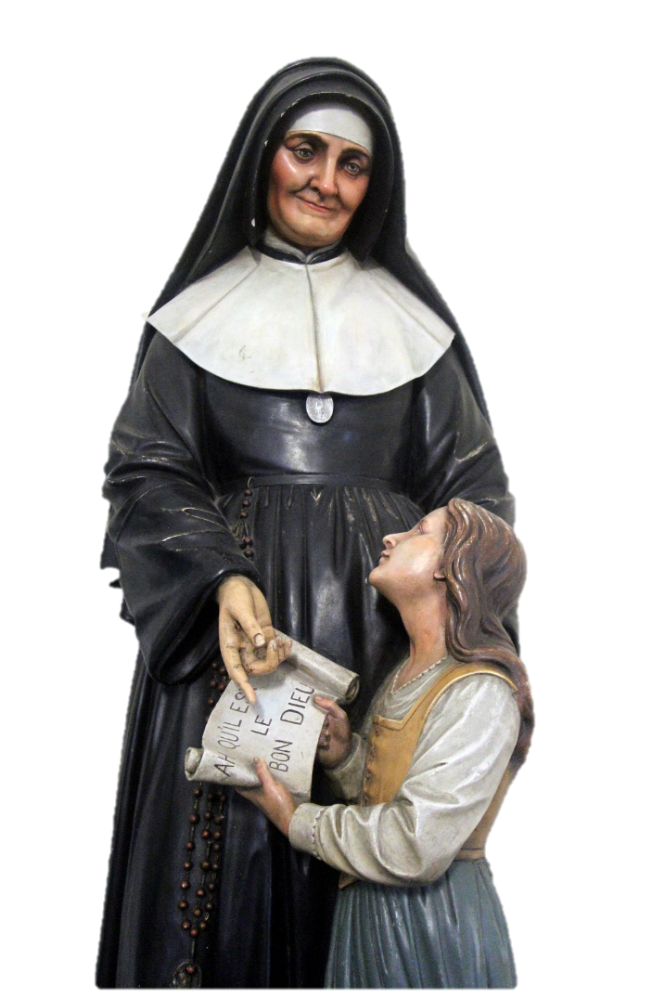
Prayers & Wisdom
God grant me the serenity
To accept the things
I cannot change;
Courage to change
the things I can;
And wisdom
to know the difference.
‘All shall be well
And all shall be well
And all manner of things
Shall be well’
Julian of Norwich
‘See the Good God
in everything.’
‘Let us do our best
and ask God
to do the rest.’
St Julie Billart
‘ALL SHALL BE WELL’ Julian of Norwich

Slide 6
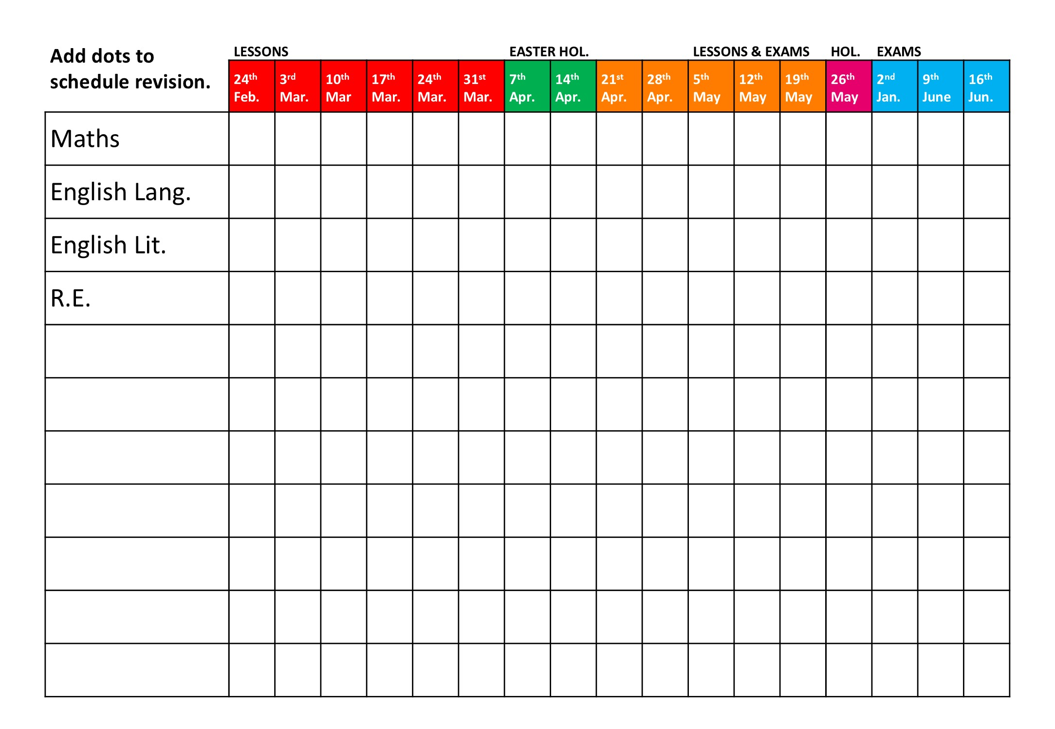
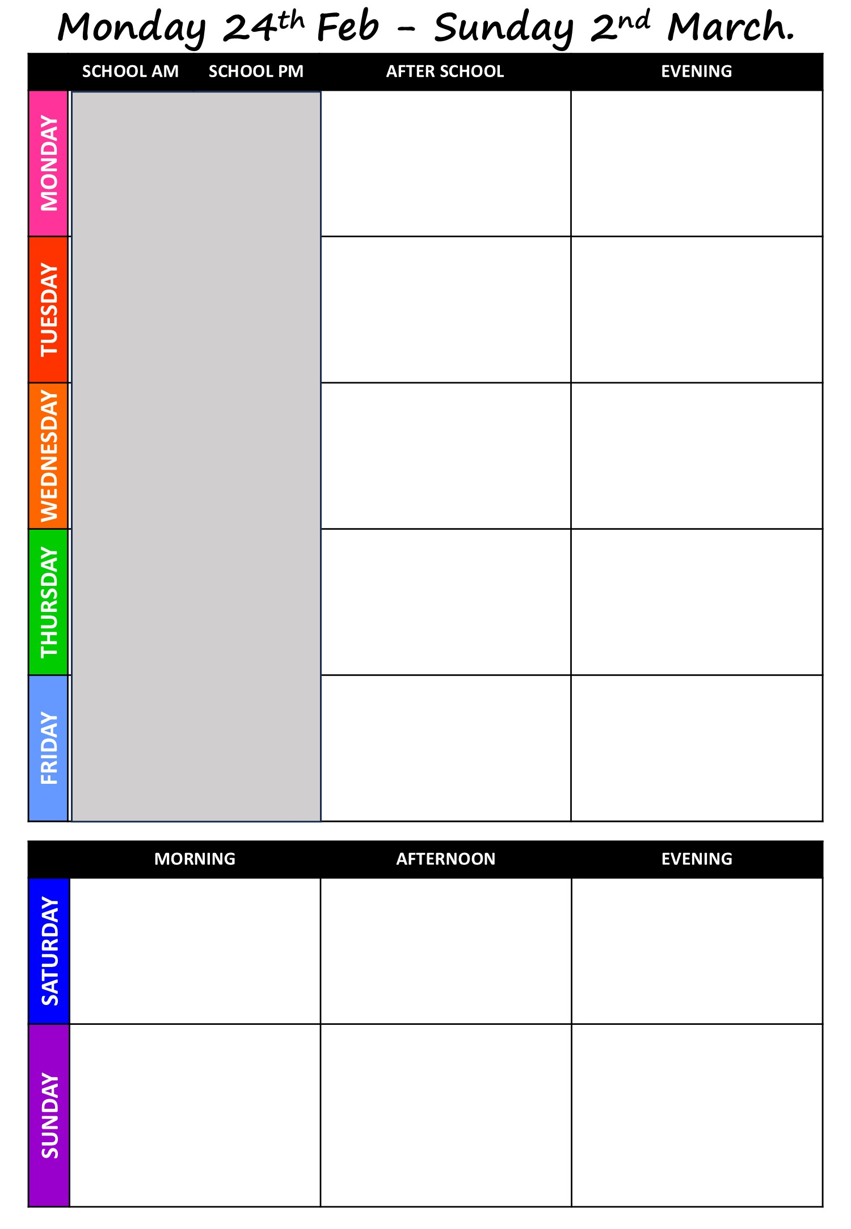



Plan Your Revision
WHAT SUBJECTS TO REVISE WHEN
Prioritise English and Maths if you are borderline 4 10 subjects \ 5 days = 2 sessions per day Consider which subjects may require more time Break each subject into key topics you need to prioritise Pair subjects that require different ways to revise Ensure that you revisit subjects to reinforce recall
Revision Tracker
Write in your subjects
Colour in the dots as you revise each subject
Daily Planner
Add downtime activities
Schedule blocks of time to revise a variety of subjects each day
Add extra sessions during holidays for priority subjects
Habit Tracker: = Sleep = Water = Wellbeing
WHERE TO LOOK FOR REVISION AND EXAM ADVICE
Go to ndhs.org.uk Click on the Student Menu. Click on Y11. Click a drop down for subject specific advice.

Slide 7
HALF TERM HOLS. 16th – 22nd Feb
 | MORNING | AFTERNOON | EVENING
MONDAY
TUESDAY
WEDNESDAY
THURSDAY
FRIDAY
 | MORNING | AFTERNOON | EVENING
SATURDAY
SUNDAY

Slide 8
Monday 23th Feb - Sunday 1st March.
 | SCHOOL AM | SCHOOL PM | AFTER SCHOOL | EVENING
MONDAY
TUESDAY
WEDNESDAY
THURSDAY
FRIDAY
 | MORNING | AFTERNOON | EVENING
SATURDAY
SUNDAY

Slide 9
Monday 2nd – Sunday 8th March.
 | SCHOOL AM | SCHOOL PM | AFTER SCHOOL | EVENING
MONDAY
TUESDAY
WEDNESDAY
THURSDAY
FRIDAY
 | MORNING | AFTERNOON | EVENING
SATURDAY
SUNDAY

Slide 10
Monday 9th – Sunday 15th March
 | SCHOOL AM | SCHOOL PM | AFTER SCHOOL | EVENING
MONDAY
TUESDAY
WEDNESDAY
THURSDAY
FRIDAY
 | MORNING | AFTERNOON | EVENING
SATURDAY
SUNDAY

Slide 11
Monday 16th – Sunday 22nd March
 | SCHOOL AM | SCHOOL PM | AFTER SCHOOL | EVENING
MONDAY
TUESDAY
WEDNESDAY
THURSDAY
FRIDAY
 | MORNING | AFTERNOON | EVENING
SATURDAY
SUNDAY

Slide 12
Monday 31st March– Sunday 6th April
 | SCHOOL AM | SCHOOL PM | AFTER SCHOOL | EVENING
MONDAY
TUESDAY
WEDNESDAY
THURSDAY
FRIDAY
 | MORNING | AFTERNOON | EVENING
SATURDAY
SUNDAY

Slide 13
EASTER HOLS. 30th March – 5th April
 | MORNING | AFTERNOON | EVENING
MONDAY
TUESDAY
WEDNESDAY
THURSDAY
FRIDAY
 | MORNING | AFTERNOON | EVENING
SATURDAY
SUNDAY

Slide 14
EASTER HOLS. 6th – 12th April
 | MORNING | AFTERNOON | EVENING
MONDAY
TUESDAY
WEDNESDAY
THURSDAY
FRIDAY
 | MORNING | AFTERNOON | EVENING
SATURDAY
SUNDAY

Slide 15
Monday 13th– Sunday 19th April
 | SCHOOL AM | SCHOOL PM | AFTER SCHOOL | EVENING
MONDAY
TUESDAY
WEDNESDAY
THURSDAY
FRIDAY
 | MORNING | AFTERNOON | EVENING
SATURDAY
SUNDAY

Slide 16
Monday 20th – Sunday 26th April
 | SCHOOL AM | SCHOOL PM | AFTER SCHOOL | EVENING
MONDAY
TUESDAY
WEDNESDAY
THURSDAY
FRIDAY
 | MORNING | AFTERNOON | EVENING
SATURDAY
SUNDAY

Slide 17
Monday 27th April - Sunday 3rd May
 | SCHOOL AM | SCHOOL PM | AFTER SCHOOL | EVENING
MONDAY
TUESDAY
WEDNESDAY
THURSDAY
FRIDAY
 | MORNING | AFTERNOON | EVENING
SATURDAY
SUNDAY

Slide 18
Monday 4th - Sunday 10th May
 | SCHOOL AM | SCHOOL PM | AFTER SCHOOL | EVENING
MONDAY | BANK HOLIDAY
TUESDAY
WEDNESDAY
THURSDAY
FRIDAY
 | MORNING | AFTERNOON | EVENING
SATURDAY
SUNDAY

Slide 19
Monday 11th - Sunday 17th May
 | SCHOOL AM | SCHOOL PM | AFTER SCHOOL | EVENING
MONDAY
TUESDAY
WEDNESDAY
THURSDAY
FRIDAY
 | MORNING | AFTERNOON | EVENING
SATURDAY
SUNDAY

Slide 20
Monday 18th - Sunday 24th May
 | SCHOOL AM | SCHOOL PM | AFTER SCHOOL | EVENING
MONDAY
TUESDAY
WEDNESDAY
THURSDAY
FRIDAY |  | Y11 Leavers Mass
 | MORNING | AFTERNOON | EVENING
SATURDAY
SUNDAY

Slide 21
HALF TERM. 25th – 31st May
 | MORNING | AFTERNOON | EVENING
MONDAY
TUESDAY
WEDNESDAY
THURSDAY
FRIDAY
 | MORNING | AFTERNOON | EVENING
SATURDAY
SUNDAY

Slide 22


Monday 1st - Sunday 7th June
 | SCHOOL AM | SCHOOL PM | AFTER SCHOOL | EVENING
MONDAY
TUESDAY
WEDNESDAY
THURSDAY
FRIDAY
 | MORNING | AFTERNOON | EVENING
SATURDAY
SUNDAY

Slide 23
Monday 8th – Sunday 14th June
 | SCHOOL AM | SCHOOL PM | AFTER SCHOOL | EVENING
MONDAY
TUESDAY
WEDNESDAY
THURSDAY
FRIDAY
 | SCHOOL AM | SCHOOL PM | AFTER SCHOOL | EVENING
TUESDAY
WEDNESDAY

Slide 24


Monday 15th – Wednesday 17th June
 | SCHOOL AM | SCHOOL PM | AFTER SCHOOL | EVENING
MONDAY
TUESDAY
WEDNESDAY
RESULTS INFO
GCSE results day is Thursday 20th August. You will receive your results by your school email address.

