Slide 1


Year 8
Work Shadowing

Slide 2
Careers Education
As part of our commitment to careers education, Friday 6th March 2026 is designated as Year 8 Work Shadow Day.
Students will not come to school on this day and instead will gain an experience of the workplace, by shadowing an employee. Students can shadow family members in their workplace or home office environment.

Slide 3

Why?
The government has produced a set of detailed accountability benchmarks (The Gatsby Benchmarks) for young people’s careers experience in schools, to better prepare them for future employment
Gatsby Benchmark 6
Every student should have first-hand experiences of the workplace through work visits, work shadowing and/or work experience to help their exploration of career opportunities, and expand their networks.
By the age of 16, every student should have had at least one experience of a workplace, additional to any part-time jobs they may have.

Slide 4
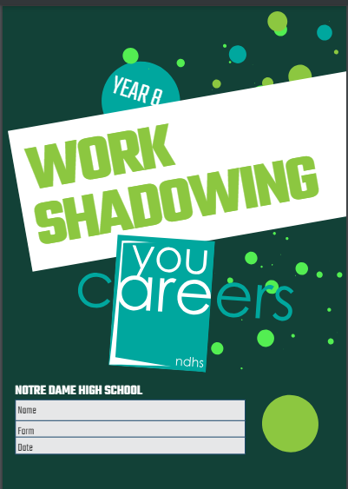
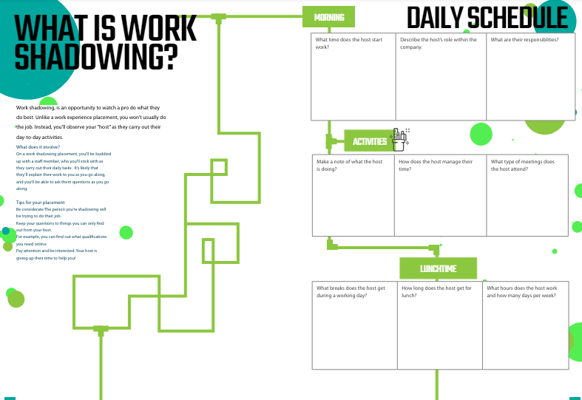
Students will be given a booklet of activities to complete while taking part in Work Shadowing, in order to reflect on the experience of the world of work and workplaces.
Our aim is to help students to recognise transferable skills required for future employment and to help guide their decision making as they move through their school career and future choices.

Slide 5

Letter
All parents/carers have been emailed a letter to explain the process. Please ensure emails are checked to access this.

Slide 6

Consent
The letter takes you to a link for a google Parental Consent Form.
https://forms.gle/GpMsVTRwA9z3hLWA9
This needs to be completed by the parent/carer so that students have permission to take part.
Without this, students will not be able to complete the work shadow day and will have to come into the school as normal.

Slide 7


There are just a few weeks to organise this but do not leave it until the last minute.
A completed Parental Consent Form must be submitted by:
Friday 13th February 2026

Slide 8
Frequently Asked Questions
My parents work in an environment that is not suitable for young people. What do I do?
You can shadow another family member, or a family friend.
My parents work from home. What do I do?
This is still a valid work place experience and you can shadow your parent in their home-office environment.
I’m not interesting in pursuing the same career as my parents do. What do I do?
Again, this is still a valid work shadow experience. It might help you to confirm your future choices or you may recognise some transferable skills.
What happens if we can’t organise a workplace day? Or my parents do not give consent.
You should come into school. Normal lessons will not run so you will be supervised to complete some work-related study.

Slide 9

Frequently Asked Questions
Can I organise a Work Shadowing experience with an employer of my own choice?
This may be possible, but parents/carers must take full responsibility for the safeguarding of their child while on Work Shadowing. The school will not take responsibility or sign employer consent forms for Work Shadowing in Y8. Formal Work Experience is offered in Y10, and this is when students will have greater choice of employers, which will be fully supported by the school.
I can’t access the online consent form.
Please email us or ask students to collect a paper form from us.
I have further questions:
Please email one of the Careers Team:
Miss Freezer – Assistant Headteacher: kfreezer@ndhs.org.uk
Mrs Holden – Careers Coordinator: rholden@ndhs.org.uk

Slide 10


