Slide 1


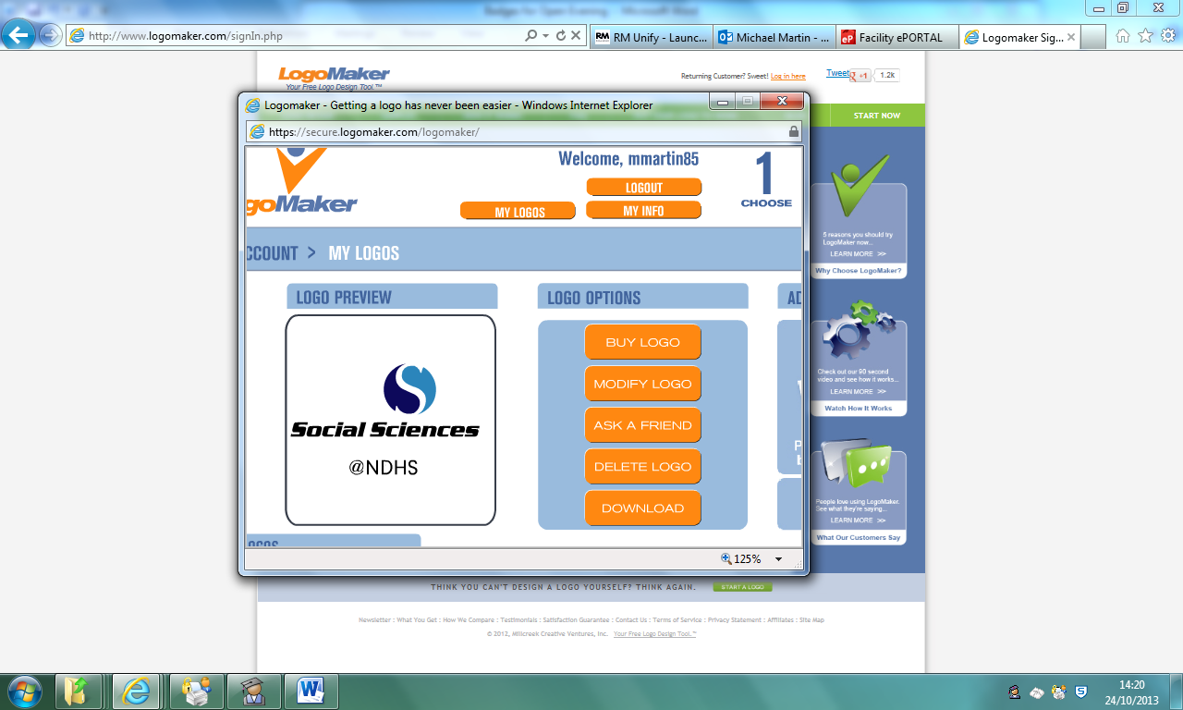
Studying Psychology at Notre Dame High
What do we do?
What do we expect?

Slide 2
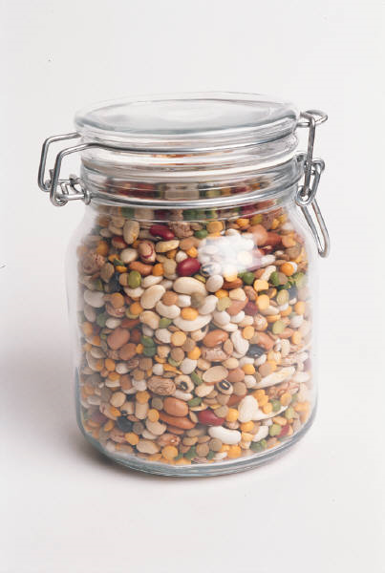

A THINKING EXPERIMENT
- Estimating Quantities -
Come in
Pass the Jar around the room and guess how many beads are in the tub
Write your guess on your sheet of paper – WITHOUT DISCUSSING YOUR CHOICE!
It must be Private – NO PEEKING!!!
G1

Slide 3
What are the Traits or Attributes required for a successful A level Psychologist?
For example …
Are interested in how people behave and explaining why
Willing to contribute to discussions
Have an enquiring mind and a scientific approach
Are happy reading and can write clearly
GCSE: at least level 5 in English, Maths and Science recommended

Slide 4
The First Year of the A level Course
Gives you a good overview of the different ways psychologists approach the subject.

Slide 5


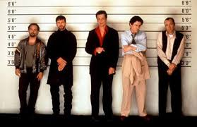
We will focus on:
Memory, including
  Models of Memory
  Why we forget
  Eyewitness testimony

Slide 6
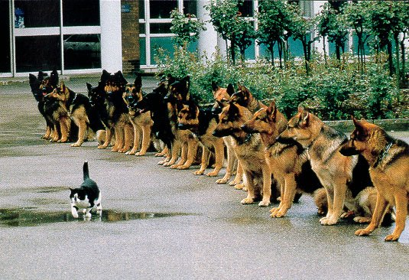


Social Psychology how other people affect our behaviour
– we look at the behaviour of individuals in a social setting or of how groups behave
We will focus on:
Social Influence including
  Conformity
  Obedience
  Resistance

Slide 7

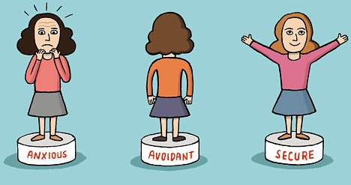
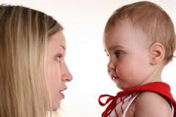
Attachment– Studies how we change as we grow older
We will focus on:
  How attachments are formed
  Different types of attachment
  Consequences of failure to form attachments

Slide 8
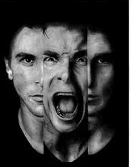

Clinical Psychology and Mental Health
– Studies how we define, study and treat mental health conditions
We will focus on:
      Definitions in the field of mental health
      Classifications; Explanations; Therapies of Mental Disorders including
        Phobias
        OCD
        Depression

Slide 9
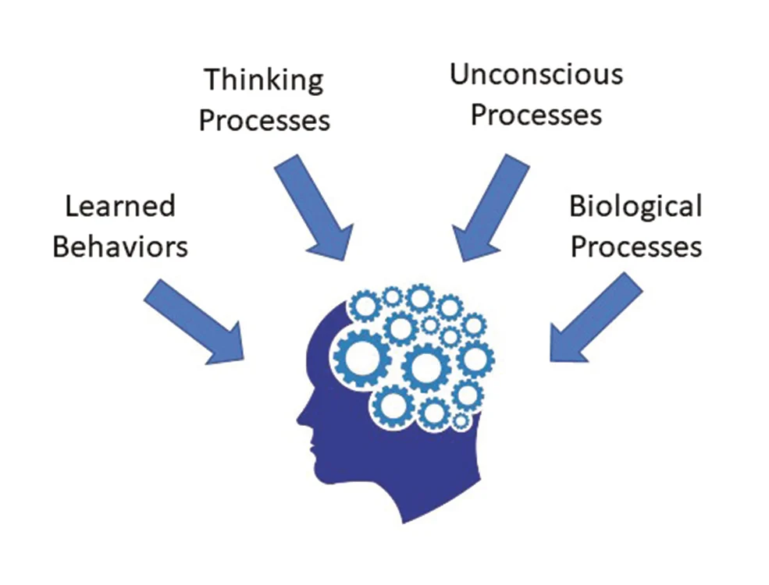
Approaches in Psychology
how the subject has developed and the different ways of studying behaviour
We focus on:
Learning Approaches
Cognitive approach
Biological approach
Psychodynamic approach
Humanistic psychology

Slide 10

Back to our study…
Talking to the people around you
You have 2 minutes to discuss how many beads you think are in the tub. At the end each group must come up with a single representative answer.
2 minutes

Slide 11
Back to our study…
Write down the group answer in the second box
G2

Slide 12
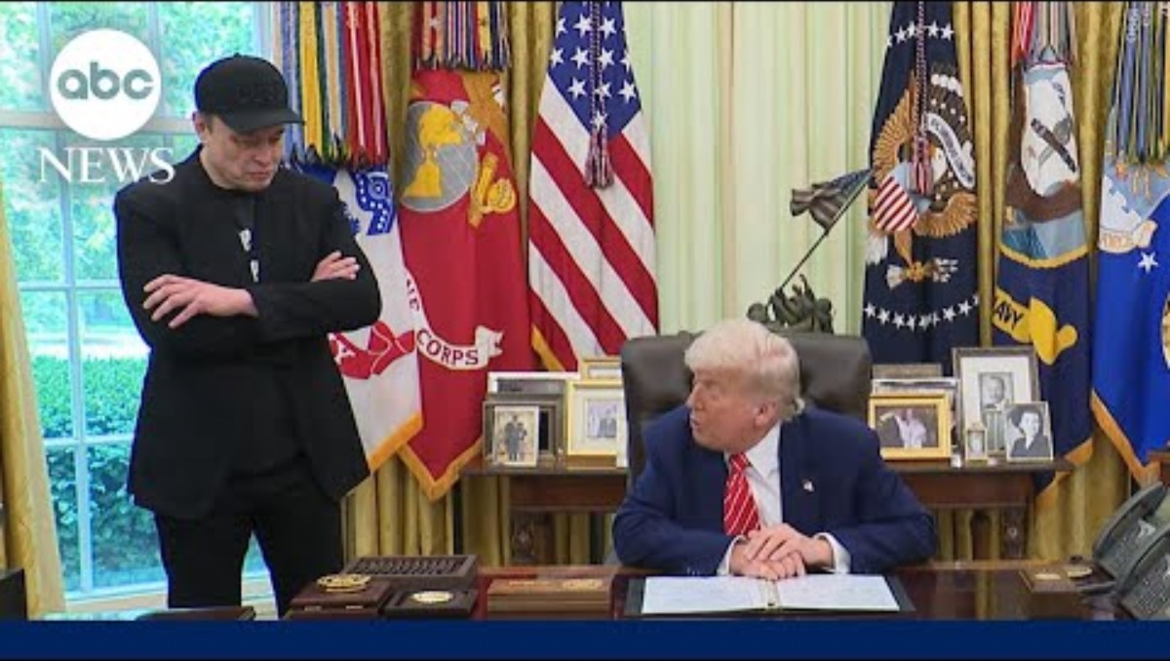
The Bromance at the White House

Slide 13


Slide 14
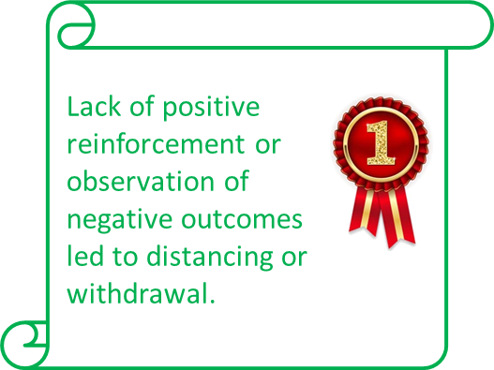
How might Psychologists explain the breakup of Trump and Musk
Let’s think about this in terms of approaches…..
Behavioural psychologists would look at learned behaviours
Cognitive psychologists might look at their thinking
Both have learnt to receive praise from others. As soon as that stops they look to withdraw.
Differences in thinking styles about loyalty and success led to misunderstanding.

Slide 15
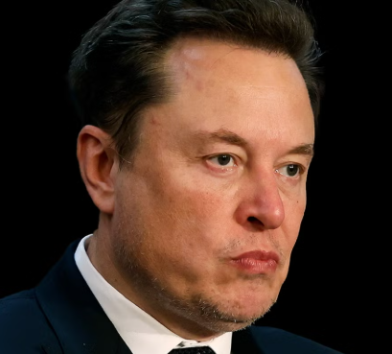


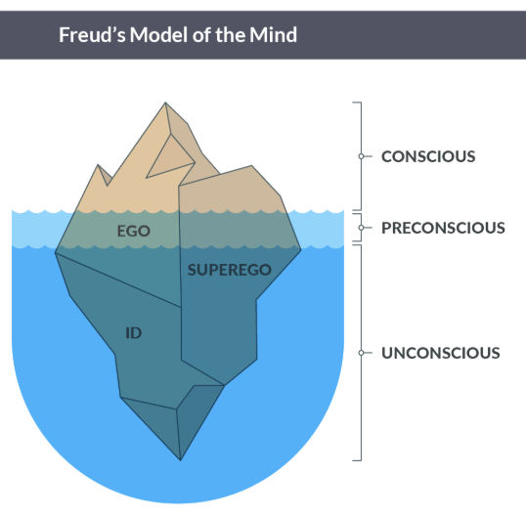
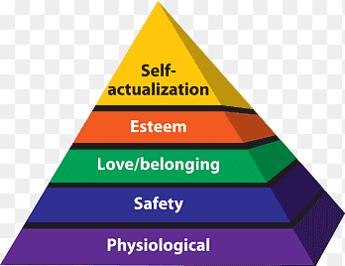
Biological psychologists might consider genes, or hormones or brain chemistry
Would be interested to find out if they had high testosterone levels as this links to confrontational
personalities
Humanistic psychologists concentrate on personal growth
Psychodynamic psychologists are concerned with early experience and the unconscious conflicts that result
One or both felt their growth was being restricted, prompting a need to separate.
Their superegos, developed in childhood, are different and make clashing more likely
Notes:
Applying Freud’s Superego Lens to Musk:
✅ Where His Superego Seems Strong:
Moral Vision & Higher Purpose
Musk is deeply driven by big ideals: sustainability, human survival (Mars colonization), advancing human cognition (Neuralink).
This suggests a strong internalized value system—a key function of the superego.
Self-Discipline
Known for intense work ethic (sleeps at factories, micromanages engineering teams).
Willing to take massive personal and financial risks for his goals.
🚩 Where It Seems Weak or Selective:
Impulse Control & Boundaries
Posts erratically on social media, often creating PR/legal headaches.
Tends to mock critics, regulators (e.g., calling the SEC the “Shortseller Enrichment Commission”).
Empathy & Social Sensitivity
Sometimes shows little regard for how his actions affect others emotionally or socially (e.g., layoffs, controversial jokes).
This can reflect underactive superego functions like empathy or moral inhibition.
Signs of a Weak Superego in Trump’s Behavior:
Impulsivity & Lack of Restraint
Frequent unfiltered speech (e.g., Twitter/X posts, insults).
Poor impulse control—often acts or speaks without considering consequences.
Lack of Guilt or Remorse
Rarely, if ever, admits fault or wrongdoing.
Doubling down even when proven wrong, indicating limited inner conflict or guilt.
Disregard for Norms & Authority
Repeated challenges to democratic institutions, legal rulings, and norms.
Behavior suggests internal rules don’t have much hold over him.
Grandiosity & Narcissism
Inflated sense of self, which often overrides moral considerations.
Focus on self-glorification over societal or ethical standards.

Slide 16
What about Year 2?
Topics include:
Biopsychology
Gender
Forensic Psychology
Issues, debates and approaches
Stress

Slide 17
But the most important thing that carries on over both years…..
Research Methods
How do we study what we study
Methods – Design – Data – Analysis

Slide 18
Back to our study…
Again in silence and without consultation
Write down another individual guess for how many beads there are in the tub – No Discussion!
G3
What have we found…

Slide 19
RESULTS / FINDINGS
Now collate your results onto the worksheet (P1)
Collect the results from 9 others (P2-P10)
  G1 – G2 – G3
Now Calculate the differences (+- not important) between:
  (G2-G1) = Diff 1
  (G2 -G3) = Diff 2
  If Diff 1 > Diff 2 then CHECK (√) with a Tick
Work out Totals and an Average for Diff 1 & Diff 2
Sketch a Graph to show the results from the Averages

Slide 20
What’s Going on?
MY PREDICTION:
I predict that for most participants, Difference 1 will be GREATER than Difference 2 (Diff 1 > Diff 2 ) because in many situations when we are unsure of an answer, we look to others for help thus Conforming to the Social Influence of a Majority.
We do this because we think they know best – this is known as Informational Social Influence and is a powerful force within Social Psychology
Other forms of Social Influence:
Lie Witness News - Coachella 2013 - 2.44

Slide 21

What’s Going on?

Slide 22
What is Conformity
A type of social influence involving a change in belief or behaviour in order to fit in with a group. This change occurs in response to real or imagined social group pressure
When we adjust our behaviour or opinions to match more closely to the behaviours/opinions of a majority of others.
Often referred to as majority influence
e.g Fashion Trends
Normative Social Influence
Why?
Informational Social Influence
When we conform to fit in with the group because we don’t want to appear foolish or be left out
– The desire to be liked
When we conform because we are unsure of a situation, so we look to others who we believe may have more information than us
– The desire to be right

Slide 23
How do we yield to Majority Influence?
Jenness – 1932
The Role of Discussion in Changing Opinion Regarding a Matter of Fact
The typicality of opinion of a group was increased
i.e. The dispersion, as indicated by the range, the quartile deviation and standard deviation was decreased
i.e. People had more similar results

Slide 24
The British Psychological Society (BPS)

Slide 25
The British Psychological Society (BPS)
https://www.youtube.com/watch?v=btDPxR-Gauc

Slide 26
SUMMER TASK – NDHS WEBSITE
Notre Dame High School - Psychology (ndhs.org.uk)
Psychology Media links
List of Films, TV Shows, Books and Magazines with relevance to material studied on the Course
Induction Day PPT
A Copy of the Powerpoint used in the Induction Lesson
ATP Transition Pack
A Pack of resources from the Association for the Teaching of Psychology (ATP) with suggestions of things to do before you join us in September

Slide 27
However…..
There is no expectation for you to do all those things listed in the transition pack
We would like you to have practised some Cornell note taking and watching or read something
https://youtu.be/nX-xshA_0m8?si=t5WTjTXDwGvRKloY

Slide 28


Slide 29


In addition….
We like the film Memento, starring Guy Pearce
And 12 Angry Men, starring Henry Fonda

Slide 30



For Year 13 when we do Forensics
Ted Bundy Tapes
Mindhunter
The Ripper

Slide 31
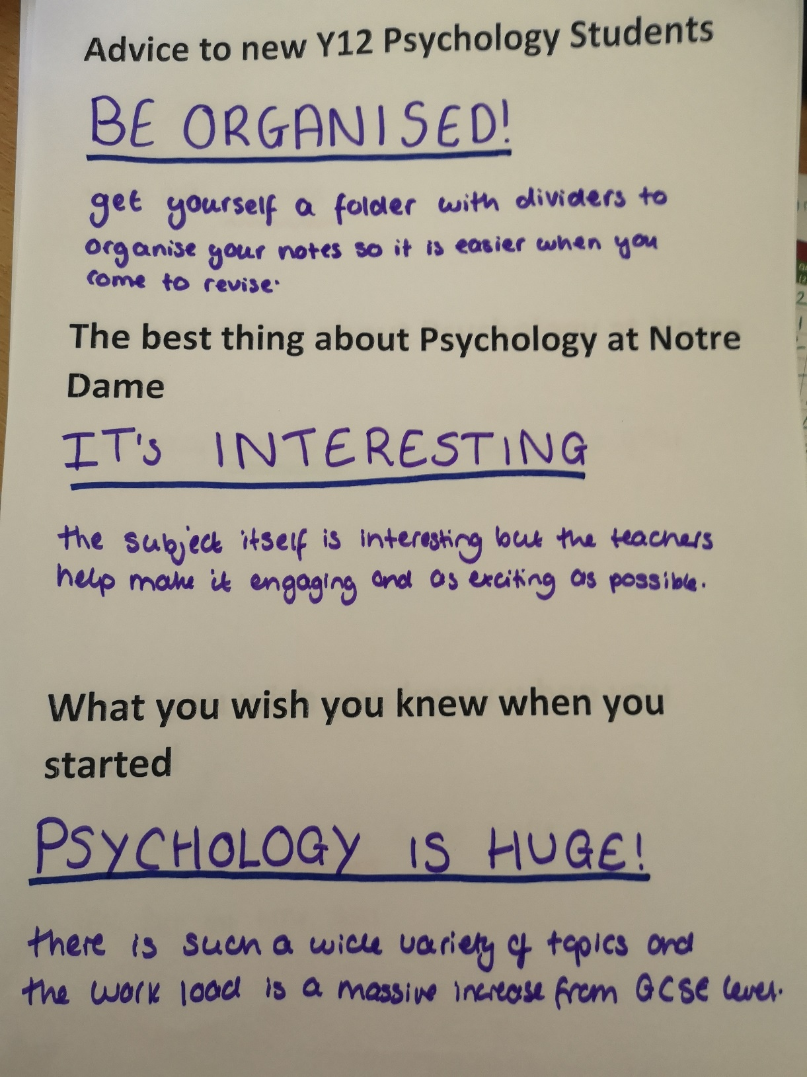
And what advice do the current Year 12 want to give?

Slide 32
CORE TEXT BOOKS – YEAR 1
We give out workbooks for each of the topics studied, but also we have the online version of the following textbook which everyone has free access to.
As the specification has changed slightly for this year, new textbooks are yet to be available.

Slide 33
SUMMER TASK – NDHS WEBSITE
Notre Dame High School - Psychology (ndhs.org.uk)
Psychology Media links
List of Films, TV Shows, Books and Magazines with relevance to material studied on the Course
Induction Day PPT
A Copy of the Powerpoint used in the Induction Lesson
ATP Transition Pack
A Pack of resources from the Association for the Teaching of Psychology (ATP) with suggestions of things to do before you join us in September

Slide 34


Good Luck on Results Day!
See you in September

