Slide 1
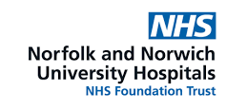
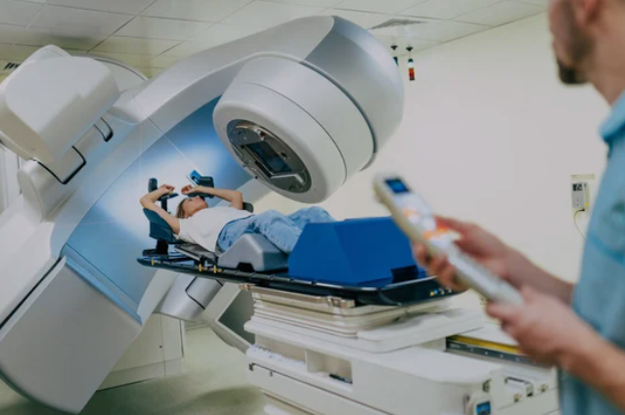
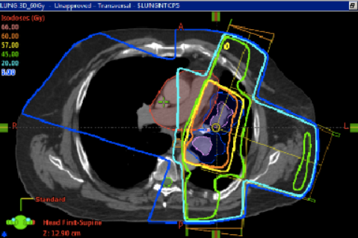
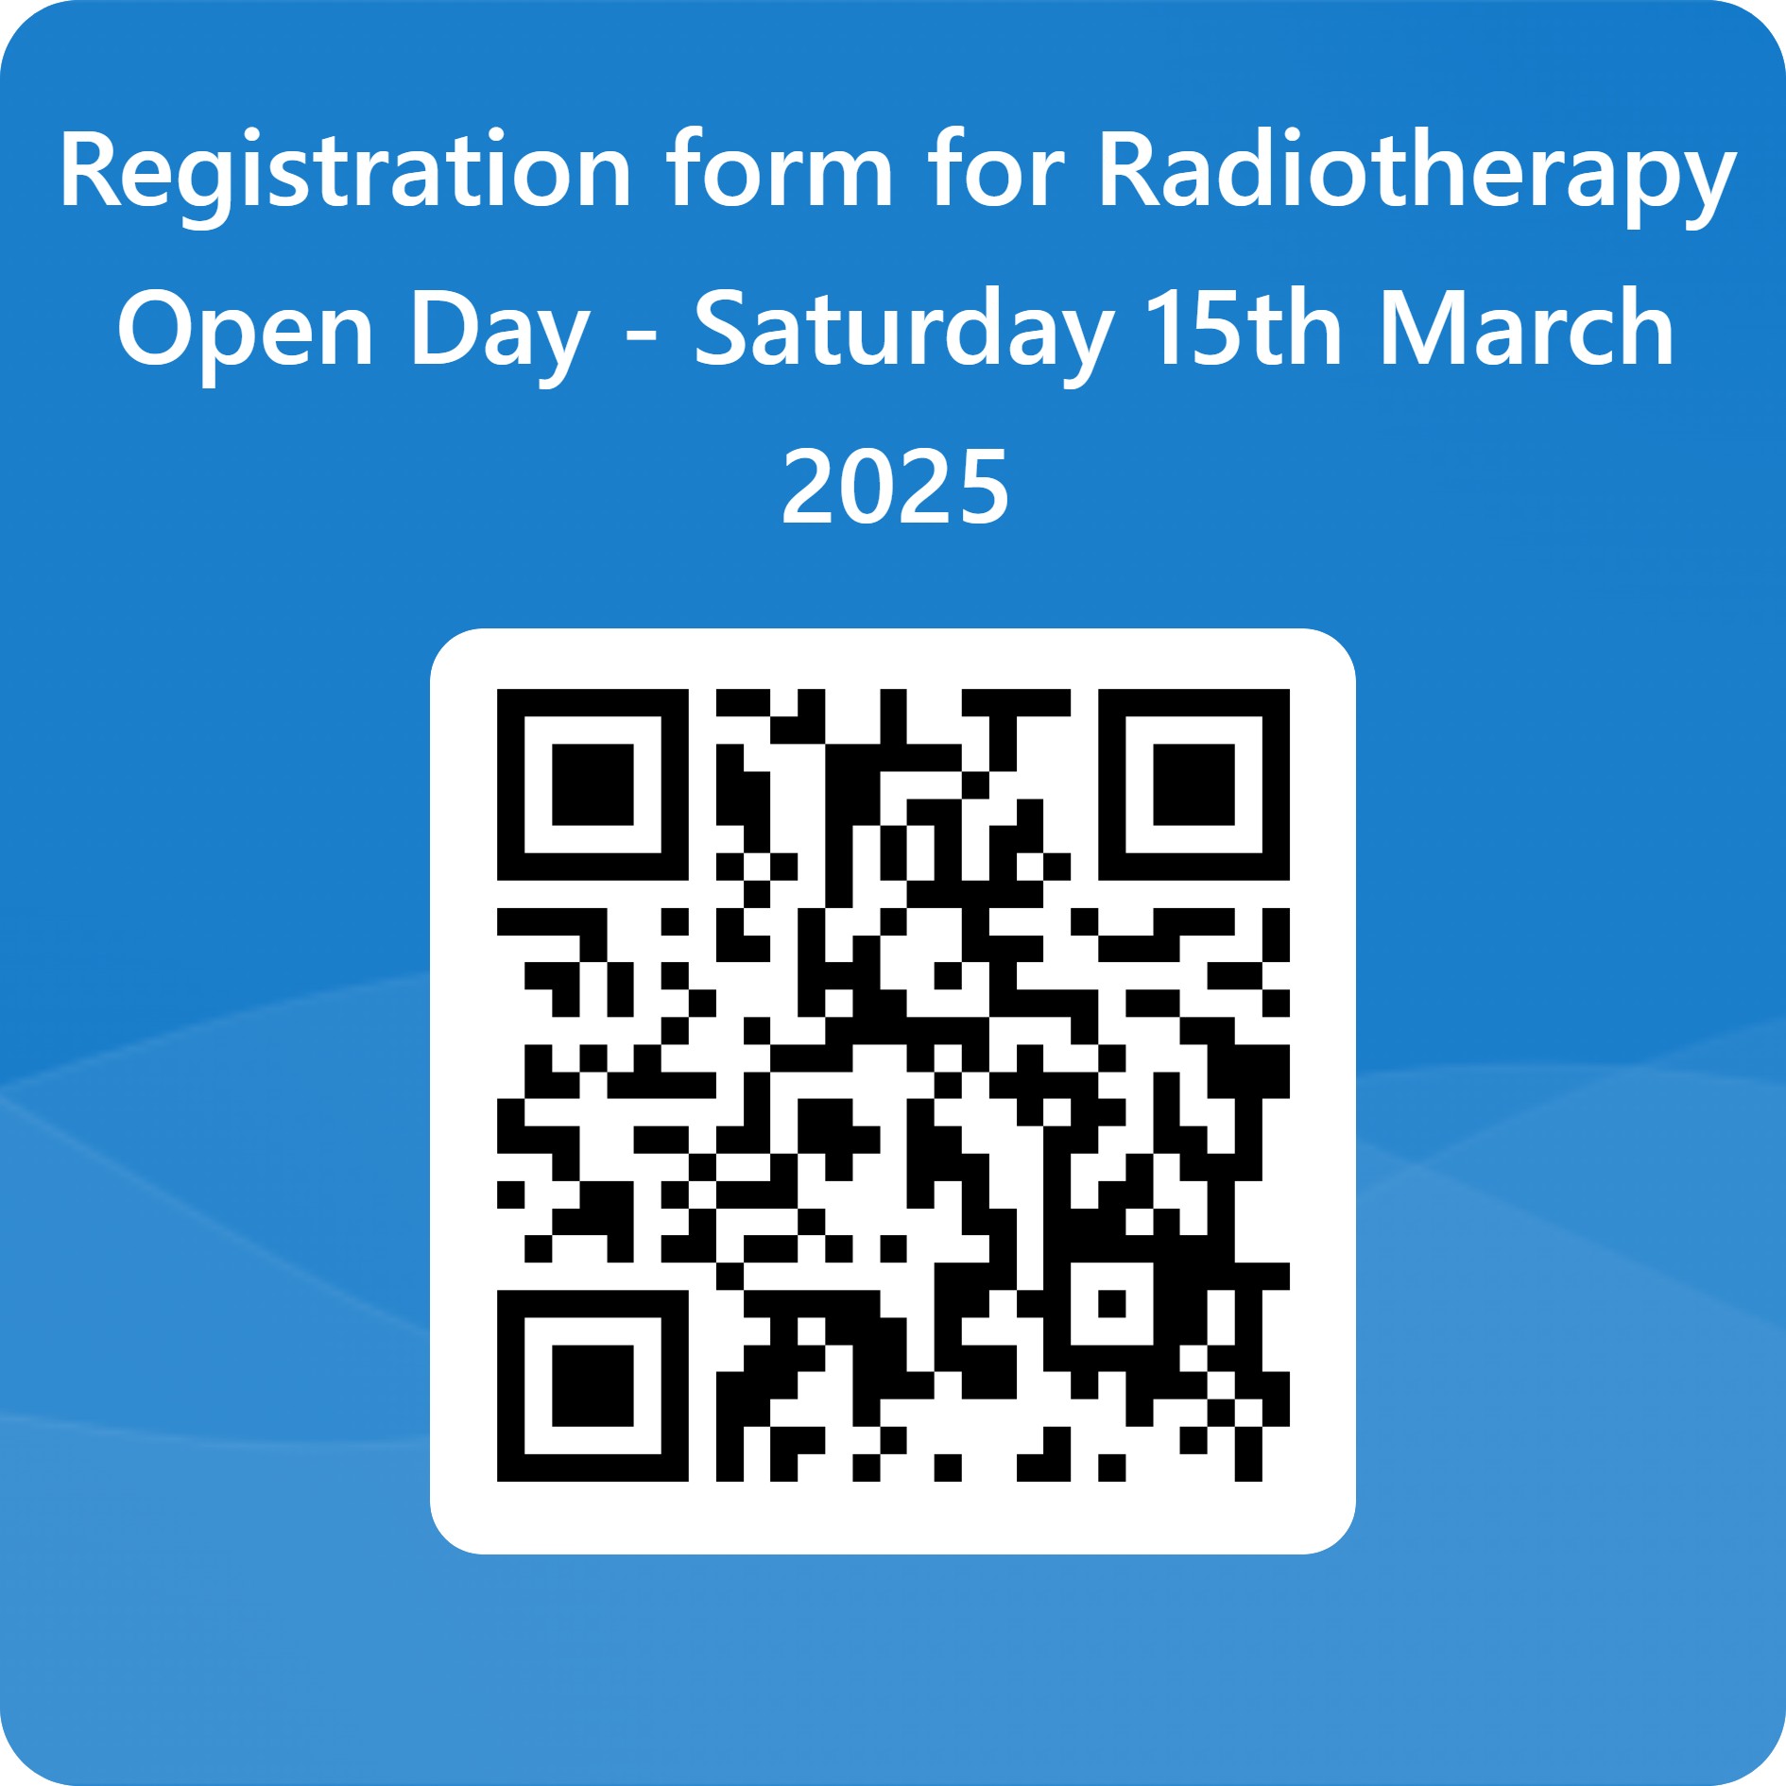
Would you like to find out more about
a career in Radiotherapy?
Saturday 15th March 2025, 2.00*- 4.30pm
*please arrive for 1.45pm
Radiotherapy Department, Colney Centre (car park J)
Norfolk and Norwich University Hospital, NR4 7UY
Radiotherapy teams care for people diagnosed with cancer. Using treatments involving different types of high-energy ionising radiation, Therapeutic Radiographers work alongside other healthcare professionals, such as Clinical Scientists, to create and administer treatment plans that blend technical expertise with emotional support and care for patients.
If you are currently in Year 11 or above, come and find out more about career opportunities within Radiotherapy at our Open Day at the Norfolk and Norwich University Hospital. Take a tour of the different areas of our department, explore a patient journey, learn about the different technology and machinery that we use and find out more about training opportunities and career progression. Places are limited so sign up now.
To register for the event, follow this link: https://forms.office.com/e/H139p856j1 or scan the QR code

