Slide 1


Name: _______________________
Form: ____________
Y12 REVISION
PLANNER
Easy to use tips
to help you revise.
NDHS
LIFE to
the FULL

Slide 2
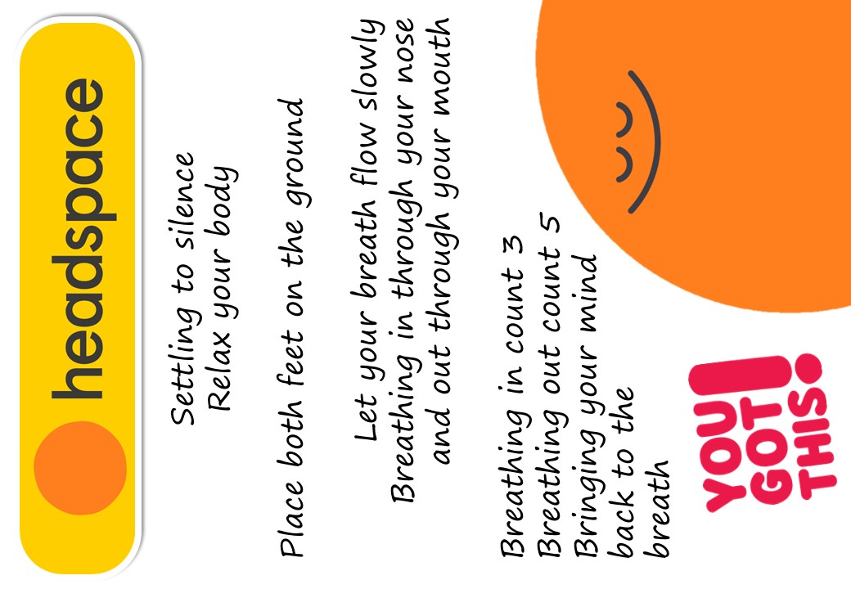
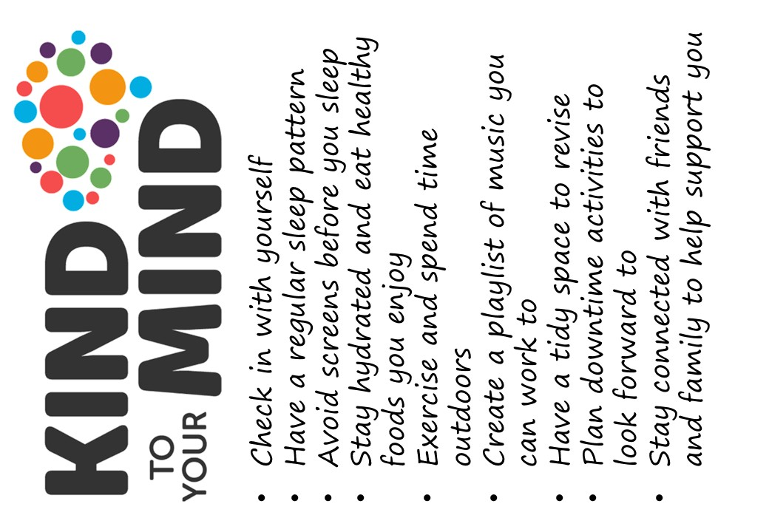

Slide 3
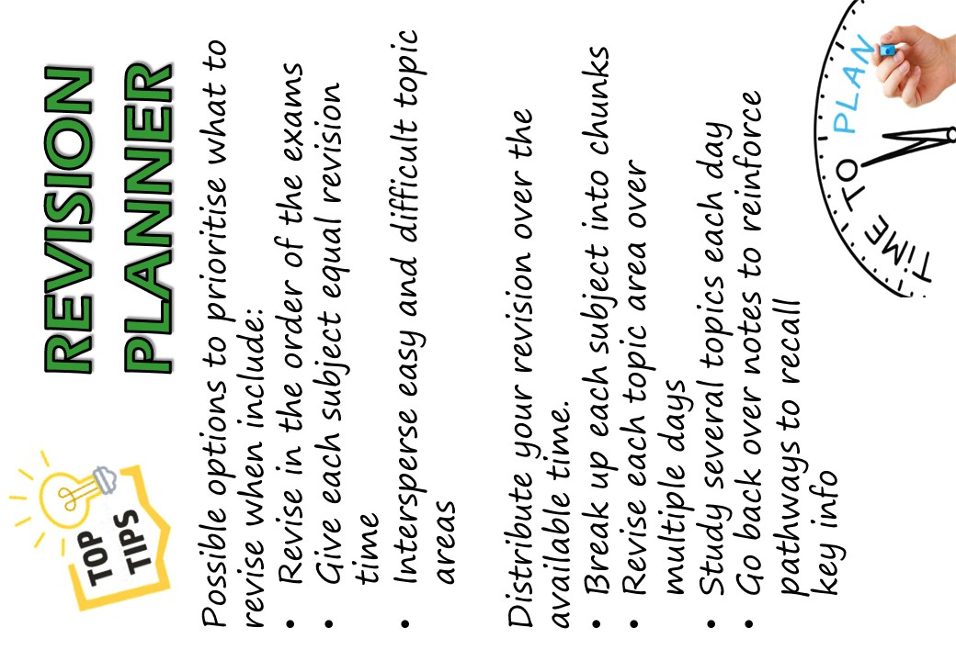
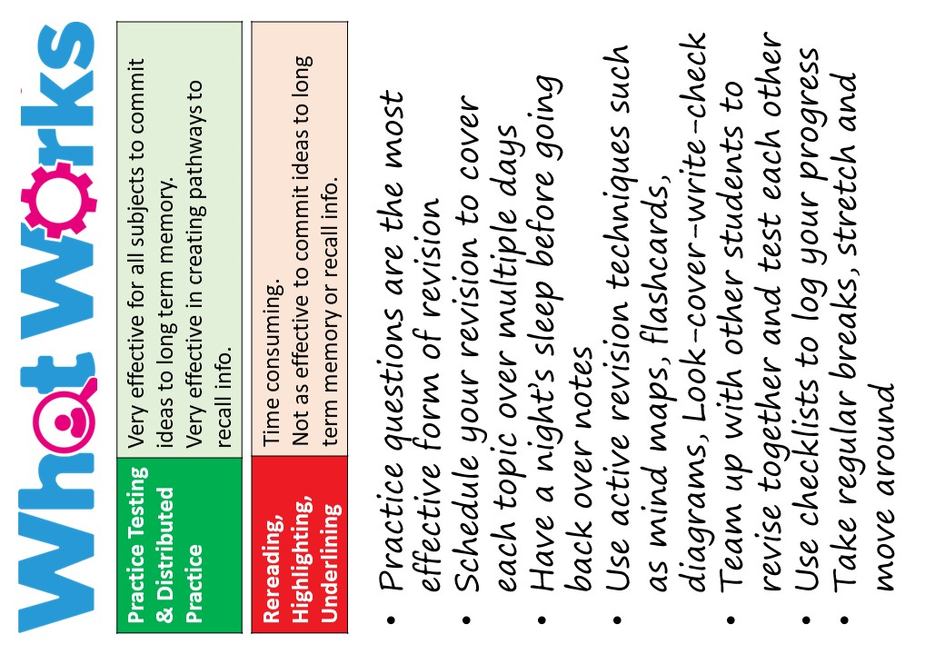

Slide 4

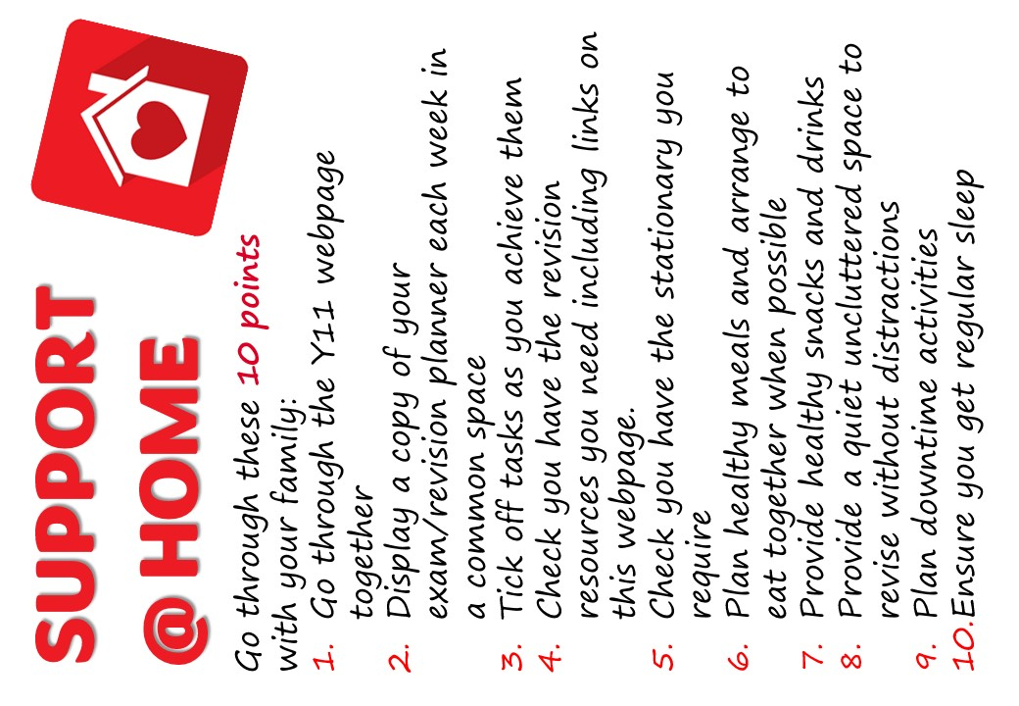

Slide 5
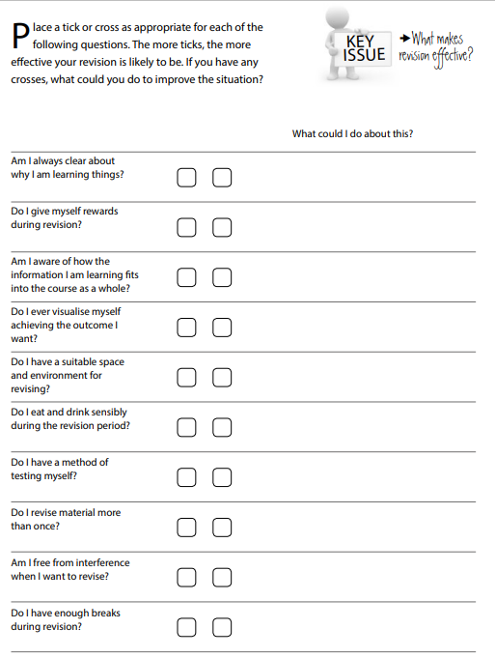
Checklist for Effective Revision
The below is from the brilliant www.getrevising.co.uk. It is full of useful ideas to help with your revision. Remember to look after yourself during your revision period and that planned downtime is a key part of any successful revision programme. Mr Fullam

Slide 6
Easter Hols. 3rd – 9th April
 | MORNING | AFTERNOON | EVENING
MONDAY
TUESDAY
WEDNESDAY
THURSDAY
FRIDAY
 | MORNING | AFTERNOON | EVENING
SATURDAY
SUNDAY

Slide 7
Easter Hols. 10th - 16th April
 | MORNING | AFTERNOON | EVENING
MONDAY
TUESDAY
WEDNESDAY
THURSDAY
FRIDAY
 | MORNING | AFTERNOON | EVENING
SATURDAY
SUNDAY

Slide 8
Monday 17th – Sunday 23rd April
 | SCHOOL AM | SCHOOL PM | AFTERNOON | EVENING
MONDAY
TUESDAY
WEDNESDAY
THURSDAY
FRIDAY
 | MORNING | AFTERNOON | EVENING
SATURDAY
SUNDAY

Slide 9
Monday 24th – Sunday 30th April
 | SCHOOL AM | SCHOOL PM | AFTERNOON | EVENING
MONDAY
TUESDAY
WEDNESDAY
THURSDAY
FRIDAY
 | MORNING | AFTERNOON | EVENING
SATURDAY
SUNDAY

Slide 10
Monday 1st – Sunday 7th May
 | SCHOOL AM | SCHOOL PM | AFTERNOON | EVENING
MONDAY | BANK HOLIDAY
TUESDAY
WEDNESDAY
THURSDAY
FRIDAY
 | MORNING | AFTERNOON | EVENING
SATURDAY
SUNDAY

Slide 11
Monday 8th – Sunday 14th May
 | SCHOOL AM | SCHOOL PM | AFTERNOON | EVENING
MONDAY | BANK HOLIDAY
TUESDAY
WEDNESDAY
THURSDAY
FRIDAY
 | MORNING | AFTERNOON | EVENING
SATURDAY
SUNDAY

Slide 12
Monday 15th – Sunday 21st May
 | SCHOOL AM | SCHOOL PM | AFTERNOON | EVENING
MONDAY
TUESDAY
WEDNESDAY
THURSDAY
FRIDAY
 | MORNING | AFTERNOON | EVENING
SATURDAY
SUNDAY

Slide 13
Monday 22nd – Sunday 28th May
 | SCHOOL AM | SCHOOL PM | AFTERNOON | EVENING
MONDAY
TUESDAY
WEDNESDAY
THURSDAY
FRIDAY
 | MORNING | AFTERNOON | EVENING
SATURDAY
SUNDAY

Slide 14
Half Term Hols. 29th May – 4th June
 | MORNING | AFTERNOON | EVENING
MONDAY
TUESDAY
WEDNESDAY
THURSDAY
FRIDAY
 | MORNING | AFTERNOON | EVENING
SATURDAY
SUNDAY

Slide 15
Mocks 1: Monday 5th – Sunday 11th June
 | MORNING | AFTERNOON | EVENING
MONDAY
TUESDAY
WEDNESDAY
THURSDAY
FRIDAY
 | MORNING | AFTERNOON | EVENING
SATURDAY
SUNDAY

Slide 16
Mocks 2: Mon. 12th – Thurs. 15th June
 | MORNING | AFTERNOON | EVENING
MONDAY
TUESDAY
WEDNESDAY
THURSDAY
FRIDAY
 | MORNING | AFTERNOON | EVENING
SATURDAY
SUNDAY

