Slide 1

Introduction to Unifrog:
For Parents
NDHS

Slide 2

What is Unifrog?
Unifrog believe that destinations - where students end up after school - is even more important than their academic performance. They partner with schools to support students to progress into the best opportunity for them.
Unifrog do this by providing a one-stop-shop where students can explore their interests, then find and successfully apply for their best next-step after school.

Slide 3
The Unifrog tools
Access all tools on Unifrog to learn what options are available, access good quality information, and search for opportunities to support your child.
Exploring pathways
Recording what you’ve done
Searching for opportunities
Drafting application materials
Making applications
Careers library
Activities
UK universities
UK Personal Statement
Post 18 Intentions
Subjects library
Competencies
US universities
Classes
Locker
Know-how library
Interactions
European universities
Subject References
Applications list
MOOC
Oxbridge
CV / Resumé
Personality profile
Canadian universities
Writing tool
Interests profile
Asian universities
Common App Essay
Read, Watch, Listen
Australasian universities
US recommenders
Webinars
ME and African universities
Notes for Reference writers
Irish universities
Special Opportunities
Events

Slide 4

Careers Library
Over 1000 career profiles
Presents information from a range of sources, including local and national LMI
Includes qualifications and skills needed, interviews with industry professionals and labour market information
Explores progression opportunities and what a working week really looks like

Slide 5
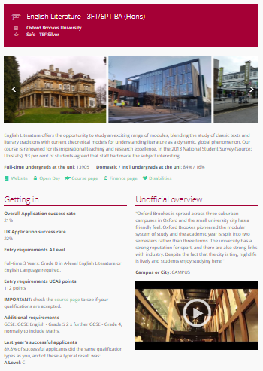
UK Universities
Students can enter subject of interest and projected grades to see all relevant university courses available in the UK
Rank and filter opportunities by factors like hours of lectures, price of accommodation and graduate job rates
Get direct links to university information pages, with impartial information on courses and institutions
Save unlimited shortlists to refer back to later

Slide 6
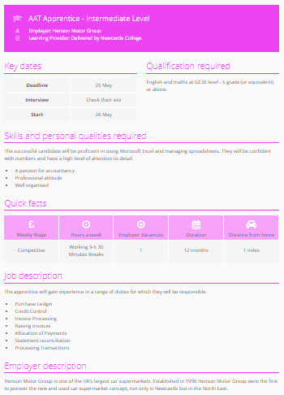
Apprenticeships
Students can find live apprenticeship vacancies
Vacancies are updated daily
Rank and filter opportunities by factors like distance from home, weekly wage and application deadlines
Direct link to the ‘apply’ page
Each apprenticeship vacancy includes practical information about the opportunity, employer and training
Save unlimited shortlists to refer back to later

