Slide 1

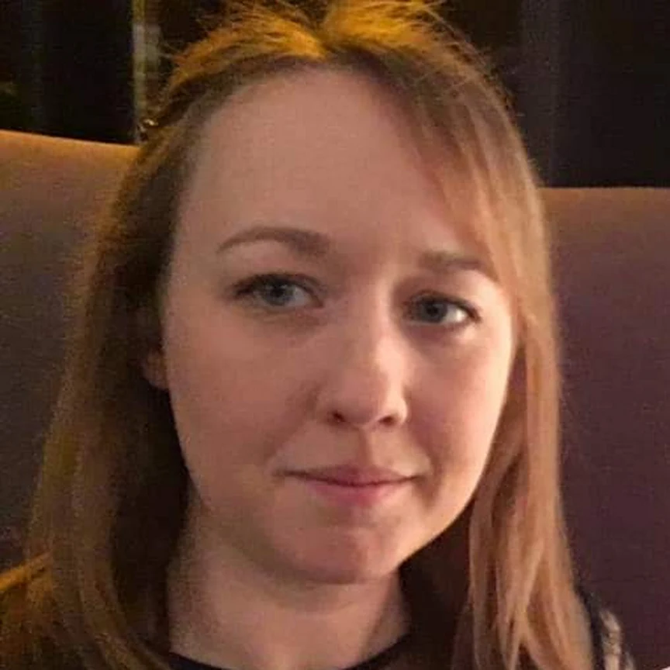
January
Tuesday 24th
Wednesday 25th
Thursday 26th
Friday 27th
12.30-1.15pm
Room P10
Careers Coordinator
Mrs Holden
Drop in to one of the Work Experience Clinic session at lunchtime for support!

Slide 2
March
Tuesday 6th
Wednesday 7th
Thursday 8th
Friday 9th
12.30-1.15pm
Room P10
Careers Coordinator
Mrs Holden
Drop in to one of the Work Experience Clinic session at lunchtime for support!

