Slide 1
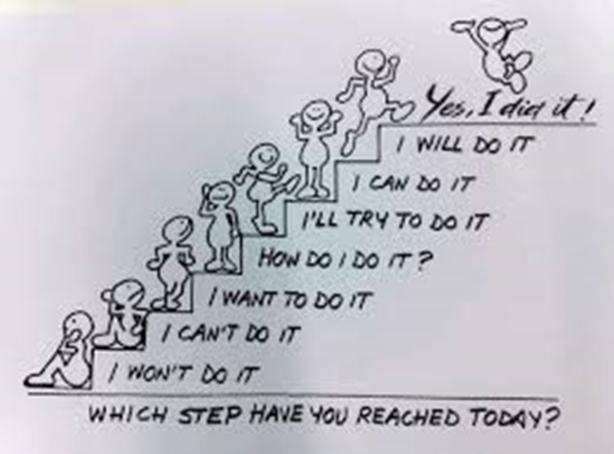
1. Exam System Assembly
26th November to 6th December.
You will have already received a timetable.
They will take place in the Sports Hall unless otherwise stated on your timetable.
Same rules and procedures apply as with GCSEs.
System helps achieve goals.

Slide 2
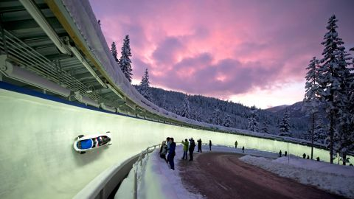
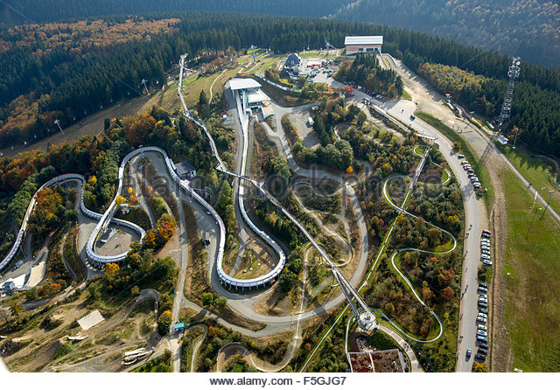
2. The Route
Summer Exams
Mocks
Year 10 Summer
Revision x4
Revision x5
Revision x3

Slide 3
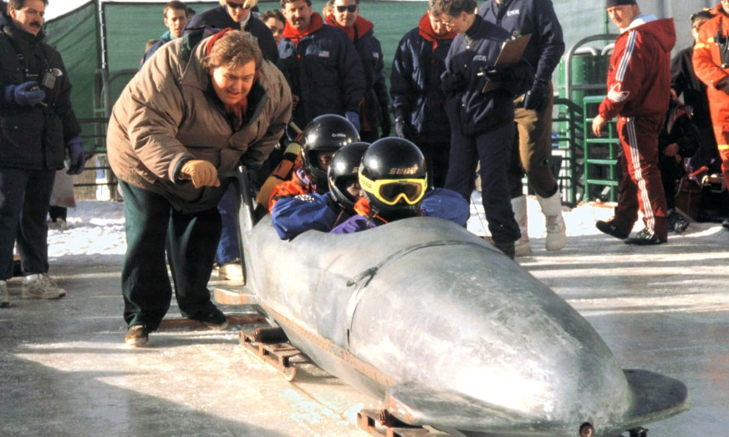
3. The Support Car... …. of which this system is part of….
Invictus [=unconquered]
I am the master of my fate,
I am the captain of my soul.
by William Henley 1888
Resources:
drawing upon..
preparing ..
focusing..
balancing…

Slide 4
Year 11 MFL Oral Exams = 25% Fri 7th – Fri 14th December
Friday 7th December
Miss Fox 11SP3
Monday 10th December
MR Faulkner Foundation
Miss Fox 11SP1
Mrs Harrison 11SP1
Tuesday 11th December
Mr Faulkner Higher
Miss Fox 11SP1
Miss Beckford 11GM
Wed 12th December
Mr Faulkner Higher
Mr Fulham 11SP2
Mr Pritchard 11JA
Thursday 13th December
Mrs Dyer 11FR1
Mrs Harrison 11SP1
Friday 14th December
Mrs Dyer 11FR1

Slide 5
4. Before the exam
1st the Seating Plan
Seating plans will be on the Exams Noticeboard under the canopy next to the Sports Hall about 1 week before the exam.
Know your seat number.
2nd The Line Up
Be in the Gym
AM exam 8.40
P3 exam go straight to S19, leave your
bag and find your seat in the hall (in
SILENCE)
PM exam 1.15pm
Please note
Please be prompt
We will register you at the exam.
If you have no exam, please go to form.
If you are not in an exam you will be in normal lessons.

Slide 6
5. What can you bring into the exam?
1st Equipment
Make sure you have all the equipment that you need for your exam - nothing will be handed out.
It is your responsibility to bring what you need for your exam.
Have spares…..
2nd The List
Pens, pencils, rulers etc. – in a clear colourless plastic bag or pencil case only.
Calculators - if relevant – but without lid.
Write in Black ink only.
Use a highlighter only on the questions and not as part of your answer.
No Tippex - cross out instead.
Present pencil case / stationery /
water-bottle as you go into the hall to the duty
staff.
NO writing on hands/arms

Slide 7
6. Water & Sweets
Water only- in a clear bottle with no label – please get this sorted in the next couple of days.
Sweets – if wanted, unwrapped, in a clear plastic bag or box.
No gum / cans / wrappers.
Labels must be removed

Slide 8
7. No Mobile Phones
In 2017, OFQUAL banned 1058 candidates for malpractice linked to mobile phones, i-watches & electronic equipment.
This may because of candidates using it under the desk, or simply bringing it into the exam room, and not declaring it; phones going off etc.
The rule: Check in the Gym than phones and i-watches are switched off and placed in your bag, ready for placing S19.

Slide 9
8. From the Gym to the Hall / Venue
Once you are sent from the Gym, you walk to the exam hall in silence via S19
S19 The Bag Room
Leave your bags/phones/i-watches and any other electronic equipment (all switched) off in S19 including calculator lids
At the door to the hall
Uniform checks – blazers; top buttons; blazer sleeves etc.
Present pencil case / stationery / water-bottle as you go into the hall to the duty staff.
In the hall
You are in exam conditions.
Place all watches on your desk.
Wait in silence – no communication / turning around - focus on you.
If you have a query, raise your hand and wait for an invigilator to check with you.
The exam prayer will be read
The Senior Invigilator will go read through the exam rules.
The exam will start.

Slide 10
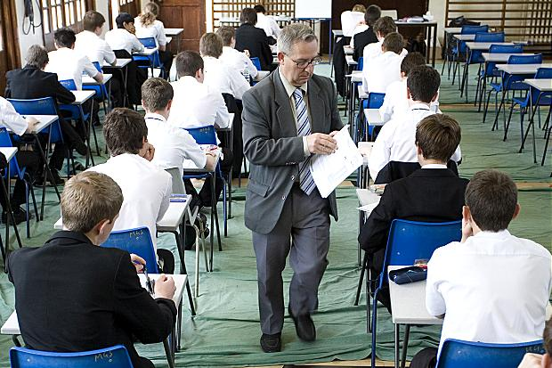
9. Our Exam Invigilators...
They apply the JCQ Exam Board rules in each exam –
they are under pressure to do so.
They are to be treated with respect – they want you to do the best you can.
If you have any queries put up your hand. An Invigilator will assist you.
There will NOT be a 5 minute warning
at the end of the exam so know your timings.

Slide 11
10. Final Information
Check the timetable for the correct day and time of your exam
Plan ahead for transport if needed
Ensure that you put your full legal name on your paper and on any additional sheets but await until instructed to do so.
If you have any queries/worries please go and see
Mrs Thompson in the Exams Office (J24)
If you are ill or delayed inform the EXAMS OFFICE on 01603-753756. Key in this number into your phone / note in your planner in FORM TIME.
Leave a message if there is no answer.

Slide 12
11. Our Exam Prayer- that moment of calm and composure
Lord God
We pray to You at this time,
as we prepare to take our Mock practice exams.
We ask You for Your gifts of
peace, and calm, during this time,
so that we can each do our best.
Help us
to do what we can,
to enjoy our achievements,
and to know how to best use our talents,
now,
and in the future,
in Your service.
We ask this through Christ our Lord.
Amen

