Slide 1
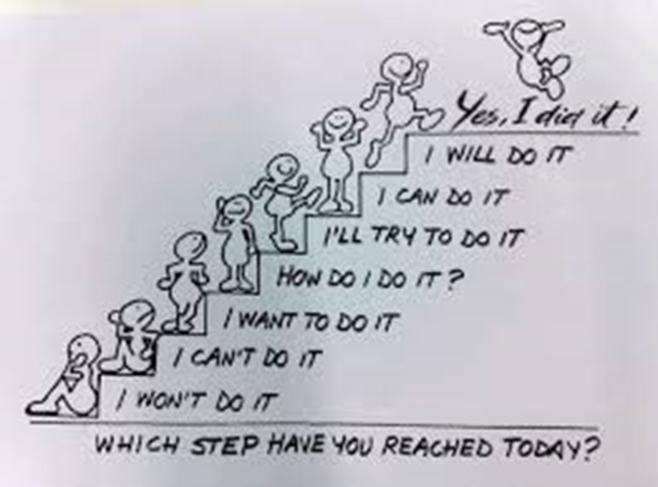

Slide 2
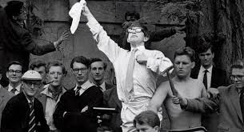
‘master of my fate, Captain of my soul.’
“Remember to look up at the stars and not down at your feet. Try to make sense of what you see and wonder about what makes the Universe exist. Be curious.
And however difficult life may seem, there is always something you can do and succeed at. It matters that you don't just give up.“
Professor Stephen Hawking

Slide 3
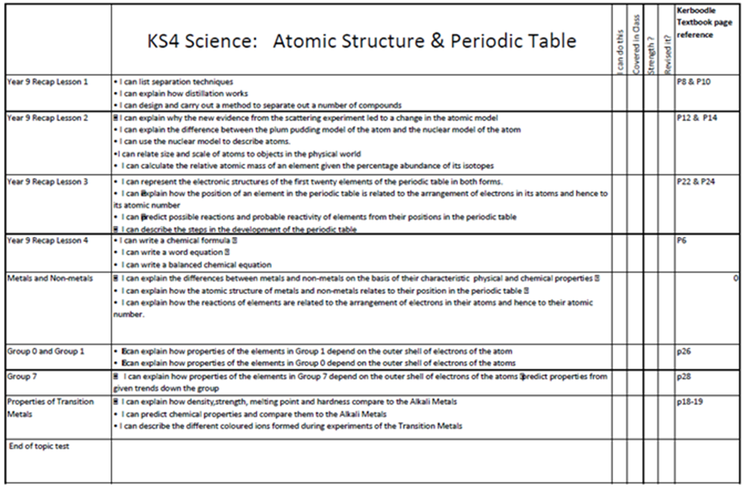
1. The What …..
See the ABC A4 sheet
For each subject the specification checklist or course topic outline
Tick, Cross or Circle each topic - and id. the VIP topics – use to prioritise – by end of March
Subject | Papers | Topics | Revision methods
English Literature | Paper 1 Paper 2
Maths | Paper 1 Paper 2 Paper 3
RE | Paper
History | Paper 1 Paper 2 Paper 3
X

Slide 4
2. The WhEN
Spaced across time – the schedule
Covering the key ‘VIP’ topics – esp. those that have the high-mark questions
Covering the ‘more tricky’ topics
Be specific about what you will cover
e.g. History, Tues PM, Elizabeth I - Religion, Cue Cards, self-test.
e.g. History, SAT AM, Elizabeth I – MQoS 16 marker – plan, do review.

Slide 5
3. The HOw ….. a reprise….!
The 10 strategies support each other.
- Will you do a practice Question for every high mark Q?
- No.
– But you can plan for the key ones and practice the critical topics.
- Then check markscheme / get a peer to review / teacher. .

Slide 6
Reminder: THE 10 RESEARCHED Revision techniques
Effectiveness | Revision method [they can build & support each other]
High – Impact | Practice testing – using cue cards / planning & writing answers / retrieving key info / checking you know…! Distributed practice - of various revision methods over time e.g. to a revision timetable – these methods!
Moderate | Elaborative interrogation of material – Why? And why? Self-explanation – what’s key here? Plans. Interleaved practice – bits of subject split up over session
Low – Impact | Summarising – key notes / cue cards Highlighting with marker to then use for summaries Keyword mnemonics - ? Imagery for text – dual-code diagrams / timelines Rereading – 1st to then make …….

Slide 7
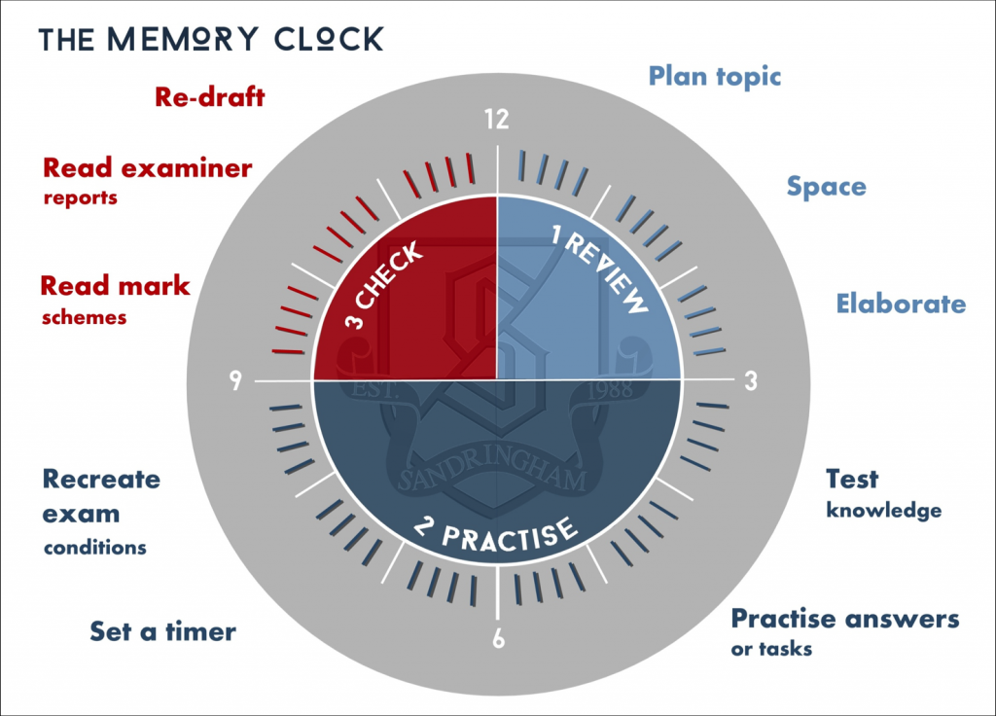
Practice Question Sequence
Review
Plan
Write

Slide 8
Needing some Exam advice?
Georgie Murdoch
I can provide confidential advice and support on things like…
At MAP we will never judge you or tell you what to do.
We can help you to make your own decisions
You can contact me by…
- Dropping in to the 6th Form office (Room 2) during first break on Friday’s
- Sending an email to NotreDame@map.uk.net
- Dropping into the MAP Life Zone in M23 on Friday lunchtimes
- Posting a message into a MAP post box (in student reception and the 6th Form area)
Wednesday 28th April 8.50-9.05 M32 – let FT know by Thurs PM for MAP list
Managing exam mindset
Managing exam stress – with proven methods
Preparing for the exam season in do-able steps

Slide 9
The Holy Trinity of distractions……use as rewards.. But phones in another room; internet off whilst workin’!

Slide 10
Notre Dame Exam Prayer adapted to revision
Lord God
We pray to You at this time,
as we do prepare and do our revision.
We ask You for Your gifts of
peace, and calm, in this time,
so that we each can do our very best.
Help us
to do what we can,
to enjoy our achievements,
and to best use our talents,
now,
and in the future,
in Your service.
We ask this through Christ our Lord.
Amen

Slide 11
Appendix – additional SLIDES

Slide 12
Checklist Revision final
The aim of revision is to prepare you for:
what will you be able to do to time, without notes, for a set of similar questions, that in style, you have already answered…
Revision is what you make it… .

Slide 13
History Tues 1hr summary for self-testing EI – create TIMELINE Colour coded by topic e.g. religion / mqs / spain History Thurs 1hr cue cards for self-testing / planning EI – Religious settlement – what/ who against & why / successes / failures History SAT 1hr – 16 marker plan & write up EI – Revolt of N. Earls
Be subject specific

Slide 14
Mid/High Mark Value Questions - plan Key ones - Practice Some - Check those

Slide 15
PRACTICE QUESTIONS – 6, 8,12, 16, 20, 40 markers…. building to practice questions to time - by planning out the answer – using cue cards / Notes - By writing up with/without notes for the big marker questions - then checking these against a mark-scheme

Slide 16
CUE CARDS Creating cue cards for - the key topics / sub-topics / Big Ideas - With key content - with key examples - with key quotes - Links to other topics / ideas

Slide 17
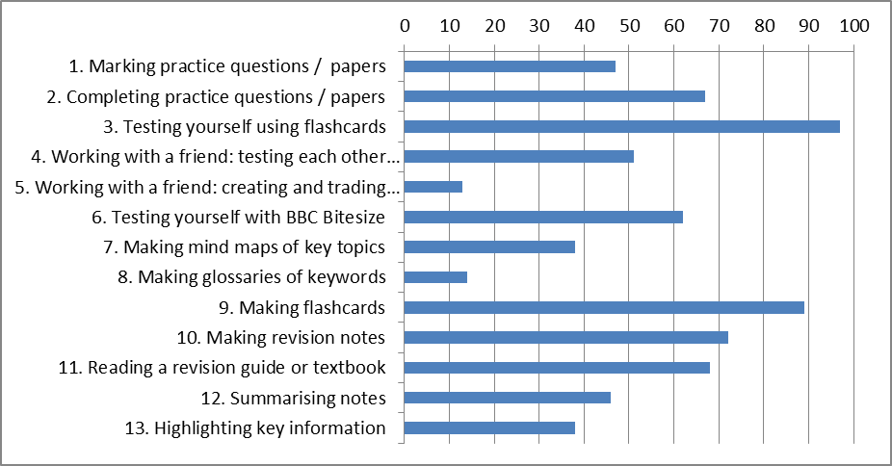
What you said: Mock revision
Hi-Impact zone: more of this?
Lo-Impact zone: use as start not finish
Use your time on the highly effective techniques

Slide 18
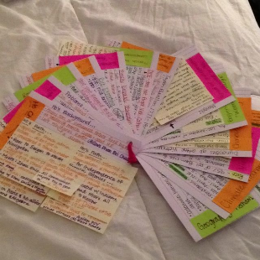
1. SELF-TESTING / PRACTICE Qs
Also known as retrieval practice –
e.g. self-testing / practice questions / quizzes /
covering notes and checking recall / using flashcards /
checking for gaps in KNOWLEDGE
a really effective way of embedding learning in memory
-
the Swahili-English paired word example
80% recall when used cf 36% recall if not used
Flashcards
Prep; plan & do PQs
Professor John Dunlosky
2. A SCHEDULE
for distributed practice
placing your revision over time
NO CRAMMING!
A Revision Plan
a.k.a schedule, a revision timetable, My Study Plan app –
leaving gaps between subjects.
Those that spaced out their learning did far better than those that crammed - [254 studies, 14,000 people, 47% recall compared to 37% for those that did cramming]
USE WHAT WORKS –
.... to maximise your time...

